Slide 1
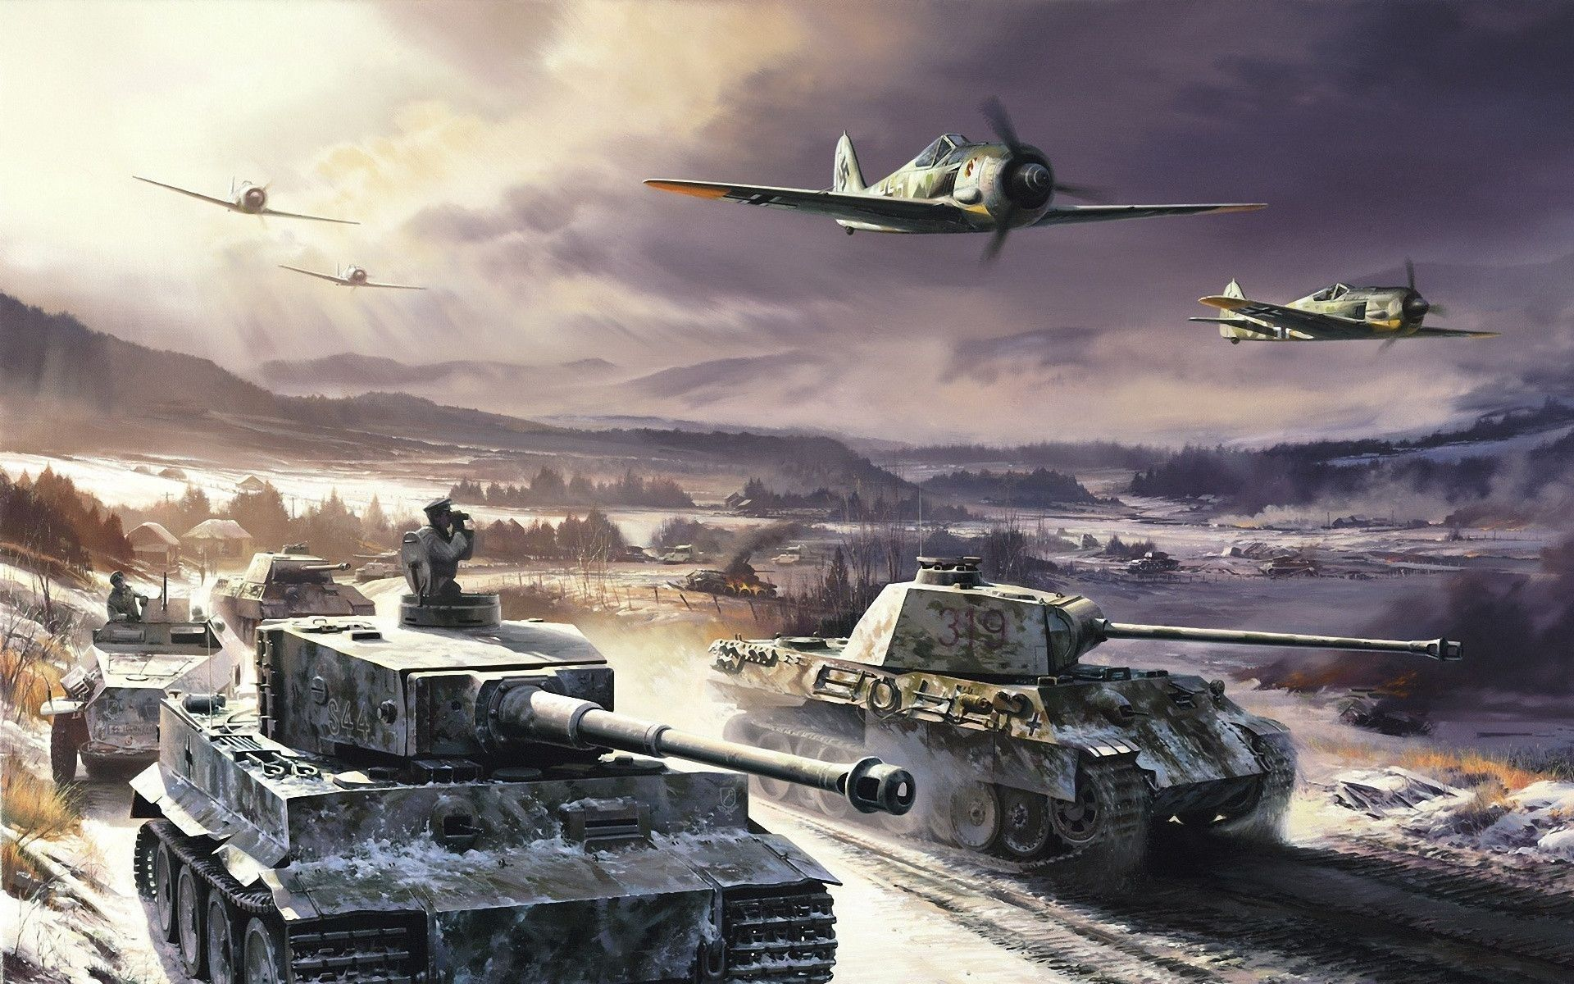
THE SECOND WORLD WAR: AN ANALYTICAL LOOK AT THE CONFLICT THROUGH THE PRISM OF THE DOCUMENTARY FILMS OF THE ERA.
Tigran Poghosyan
Dr. Melissa Beattie
EC299

Slide 2
Contents
Introduction
Literature Review
Research Question
Methodology
The Process of Analysis
A brief analysis of the Aesthetics and the Propaganda aspects of the films
Conclusion
References

Slide 3
Introduction
For the final paper I have decided to write about the second world war and examine it through two documentary films, “Triumph of the Will” and “Triumph over Violence” by Leni Riefenstahl and Mikhail Romm respectively
With the help of the analysis of the two films I am going to explain the details connected to the war, its process and its outcome

Slide 4
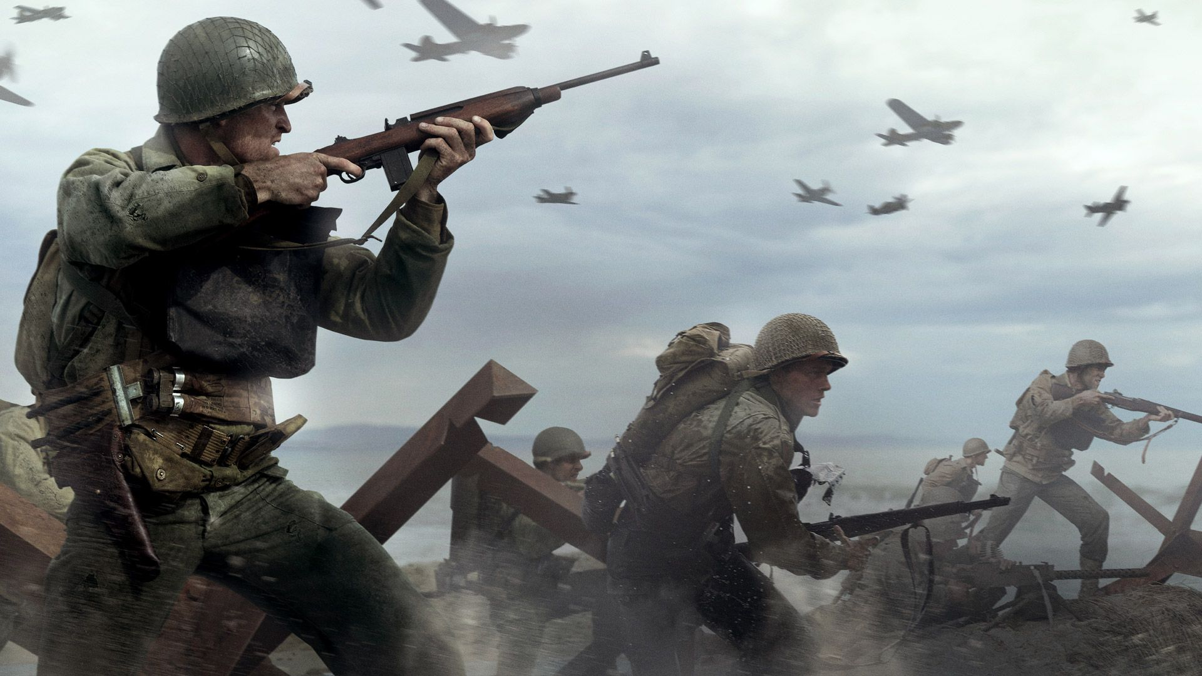
Literature review
Ryan, C. (1994). The last battle: The classic history of the battle for Berlin. Simon and Schuster. Propaganda as vision: Triumph of the will - logos. (n.d.). Retrieved May 11, 2022, from http://logosjournal.com/kelman.pdf - This work analyses the final days of war and the battle of berlin
Welch, D. (2006). The Third Reich: Politics and propaganda. Routledge. – this work will allow the understanding of political programs and propaganda management present in the films
Rees, L. (2021). In Hitler and Stalin: The tyrants and the Second World War. essay, Public Affairs, Hachette Book Group- this work will allow a more closer inspection into the character of Hitler as the leader of the Third Reich
Fussell, P. (1990). In Wartime understanding and behavior in the Second World War. essay, Oxford University Press.- this work is going to aid in the realization of the situation of the civilians and soldiers fighting on the front.

Slide 5
Research questions
The main point I am going to be addressing is how the understanding of the second world war is going to further help establish a pathway towards figuring out solutions to the problems of today. Basically, the question is going to be “how the war, as an occurrence with an abundance of examples of every area of life involving events that it has, is still not thoroughly understood by today’s society, and how that brings about problems that have already been solved in the past.” I think by sticking to these two fields of research I can potentially come close to the reader’s and my personal understanding of how the acceptance and the continuous learning of the facts of the past will allow for a subconscious mechanism of moral building to occur.

Slide 6
Methodology
For the realization of my goal, I will need to go about the process step by step. I have chosen two documentary films which I will analyze that will help me illustrate all the points carefully and not dwell into details that may be too obvious or redundant. One of the documentaries I am going to use is the “Triumph of the Will” or “Triumphs des Willens” originally from German. This documentary will allow me to dissect the information regarding the ritualistic aspects of Nazi Germany and it also serves as many historians reason for believing that people were drawn into the whole scheme, because of said grandiose representations.

Slide 7
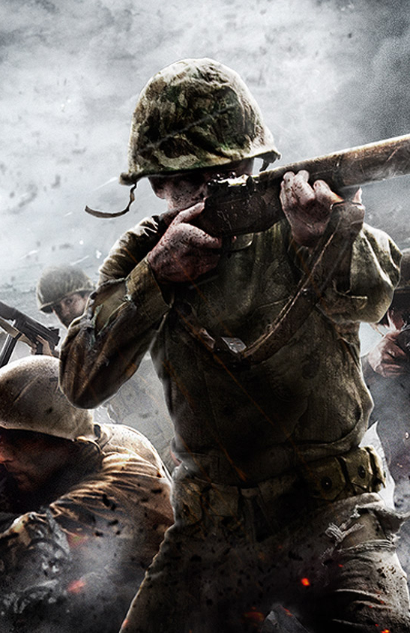
Methodology. continued
The Second documentary I am going to use is called “Ordinary Fascism” or originally in Russian “Обыкновенный фашизм.” It was made in 1965 in the Soviet Union and it is the gateway of understanding for the Soviet population at the time of what the war meant and how its end serves as an example for the world today. This film if filled with propaganda from the side of the Soviet government however it is still a great representation of the war through the eyes of the soviet citizen.

Slide 8
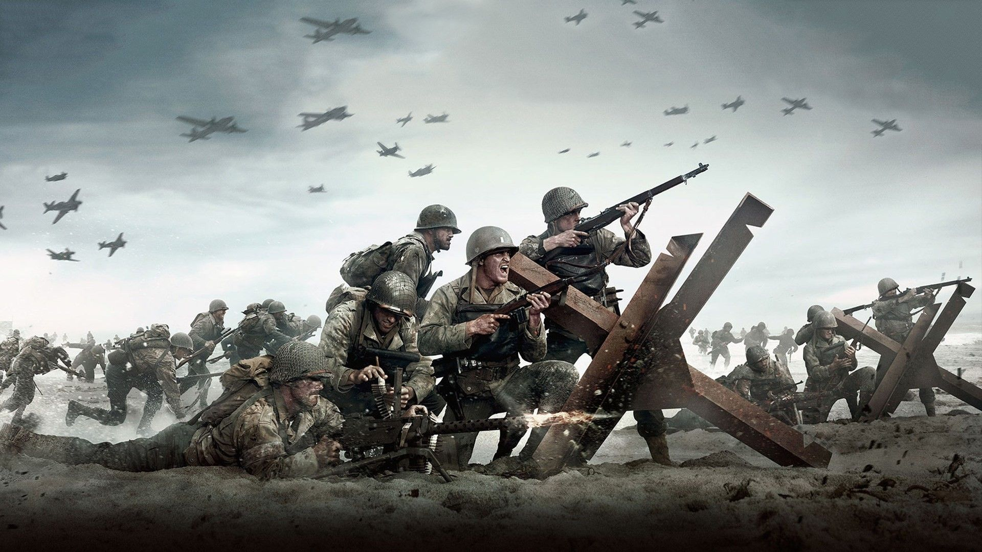
The Process of Analysis
The aspects of the Nazi regime are going to be thoroughly depicted with regards to their ritualistic, symbolic and philosophical connotations.
Within the paper I am also going to go in depth within the propaganda concepts that the films have within them, as well as an overall aesthetic analysis of the films will be done on the premise of those elements acting as guide points for the aforementioned criteria.
By using all of the abovementioned methods, I will hopefully explain the inner working systems of Nazi politics, ideology and dogmatism.

Slide 9
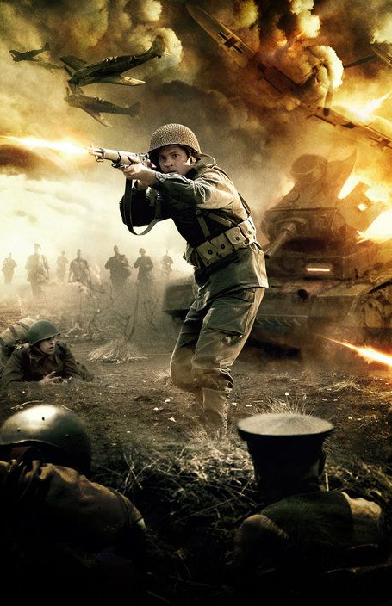
The Nazi Propaganda Machine
It would be difficult to pinpoint exactly what kind of machinations the Nazi Regime used in order to spread influence over the populace but some things are fairly obvious.
With the use of various communications channels and the establishment of certain “Nationalistic” rituals, The national socialist party managed to completely win over the majority of the German population.

Slide 10
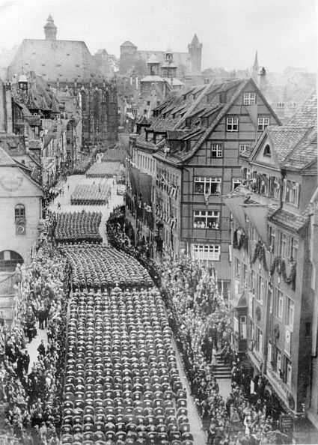
The Aesthetics of the Riefenstahl Film
The communication aspect was based on many components ranging from radio broadcasts to posters, flags and various events.
Where as the visual/ritualistic area of notice is very much apparent from the documentary film “Triumph of the Will.”
There, the use of imagery, the positioning of the scenes and their continuity is effectively utilized in way that creates a grandiose feeling.
With those sort of mechanism the Nazi party eventually established itself as the ruling body of Germany, thanks to the impressionable nature and the gullibility of the majority of Germans in those days.

Slide 11
A Brief Overall Analysis
Taking everything into consideration it is obvious that the two films depict two very different Germanies. Or rather two very differing portrayals of the same country.
With the Romm film we see that the vast majority of scenes accompanying the narration are meant to mock the Nazi state, and show the disasters it brought onto the world.
With the Riefenstahl film we see in some sense a simplistic representation of the Third Reich that Hitler wanted everyone to see and admire

Slide 12
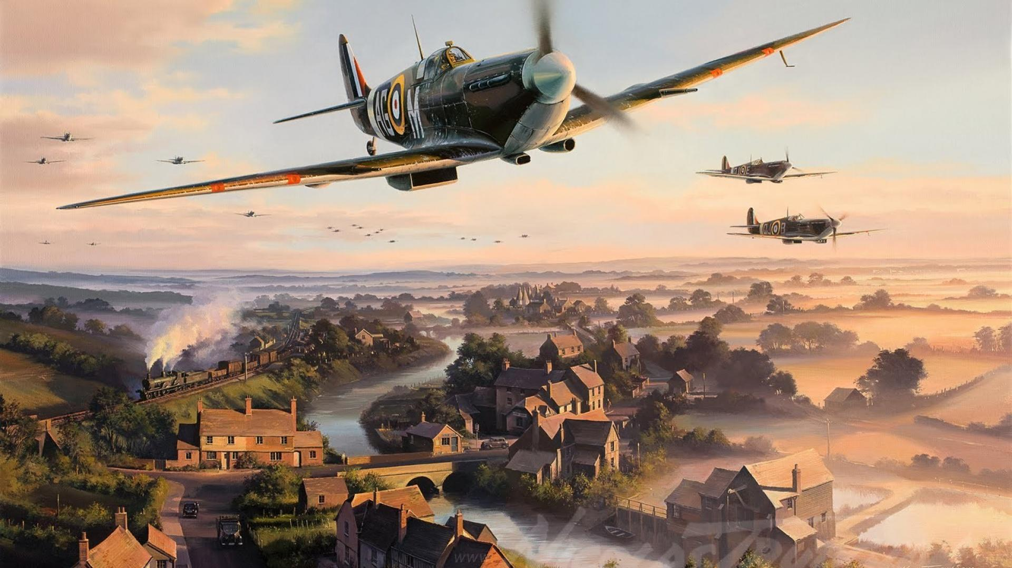
Conclusion
When looking back at the conflict with all of the details regarding its conception, its duration and the eventual outcome, one thing becomes clear. Both the Nazi regime and the Soviet Union were states that demanded allegiance to their ideals and most importantly to one figurehead, that was placed in charge. The similarities between those ruling parties are so striking in fact, that to this day many political-historical analysists cannot give a conclusive answer regarding the nature of the Nazis. Where the Soviet Union kept clyster clear to its ideology the, National Socialist party has remained ambiguous as to its allegiance either to the political left or right. That question may never be answered to completion, but one thing remains certain. The states were mirroring each other throughout the entire course of their existences.

Slide 13
Conclusion
Regarding the paper and the analysis which I have done within it, I believe that by looking upon the documentary films that I have chosen the socio-political, psychological and ideological elements of the Nazi state in particular becomes easier to understand overall. The Nazis did not really want to hide anything from the world, and have made their actions fathomable for every person who lived in those times. That and of course the scale of the conflict, are the reasons the vast majority of people know the word Nazi and the name Hitler. History and fate have collided and put the second world war, as the crossroad not only for humans in those times to choose which direction they would prefer to go, but also for people today to realize why those events need to always remain unforgotten. The war and its outcome are why we live today in the world we know, and why people have to realize the importance of “Today.”

Slide 14
References
McLaine, I. (1979). Ministry of Morale: Home Front Morale and the Ministry of Information in World War II (1st ed.). Routledge. https://doi.org/10.4324/9781003190646
Suleiman, S. R. (1970, January 1). Susan Rubin Suleiman, crises of memory and the Second World War. PhilPapers. Retrieved November 19, 2021, from https://philpapers.org/rec/SULCOM.
Fussell, P. (1990). In Wartime understanding and behavior in the Second World War. essay, Oxford University Press.
Suleiman, S. R. (2012). Crises of memory and the Second World War. Harvard University Press. .
BEEVOR, A. N. T. O. N. Y. (2021). In Stalingrad. essay, LITERA MEDIA GROUP.
Aleksievich, S., Pevear, R., & Volokhonsky, L. (2018). In The unwomanly face of war. essay, Penguin Books.

Slide 15
References
Guilford Press. (1989). Science & Society: General index volumes 26-50 (1962-1986/87).
Welch, D. (2006). The Third Reich: Politics and propaganda. Routledge.
Black, E. (n.d.). The horrifying American roots of Nazi eugenics. History News Network. Retrieved May 11, 2022, from https://historynewsnetwork.org/article/1796
Thompson, L. V. (1989). Lebensborn and the eugenics policy of the Reich Fuhrer- SS. The „Final Solution“, 601–624. https://doi.org/10.1515/9783110970470-014
Adena, M. (2013). Radio and the rise of the Nazis in prewar Germany. Centre for Economic Policy Research.
Triumph of the will. (1934).
Triumph over violence. (1965).

Slide 16
References
Rees, L. (2021). In Hitler and Stalin: The tyrants and the Second World War. essay, Public Affairs, Hachette Book Group.
Rees, L. (2021). In Hitler and Stalin: The tyrants and the Second World War. essay, Public Affairs, Hachette Book Group.
Mann, Y. (2013). The Leningrad Blockade, 1941–1944: A new documentary history from the Soviet Archivesby Bidlack, Richard and Lomagin, Nikita. The Journal of Slavic Military Studies, 26(4), 723–725. https://doi.org/10.1080/13518046.2013.844564
Keneally, T. (2019). In Schindler's ark. essay, Sceptre

Slide 17
References
Tobias, F., Pomerans, A. J., & Tobias, F. (1964). In The reichstag fire. essay, Putnam.
Ryan, C. (1994). The last battle: The classic history of the battle for Berlin. Simon and Schuster.
Propaganda as vision: Triumph of the will - logos. (n.d.). Retrieved May 11, 2022, from http://logosjournal.com/kelman.pdf
Kivelson, V. A., & Neuberger, J. (2010). Picturing Russia: Explorations in visual culture. Yale University Press.
Brearley, M. (1988). Hitler and Wagner: The leader, the master and the Jews. Patterns of Prejudice, 22(2), 3–22. https://doi.org/10.1080/0031322x.1998.9969950
Golomb, J. (1997). Nietzsche and Jewish culture. Routledge.

