Slide 1
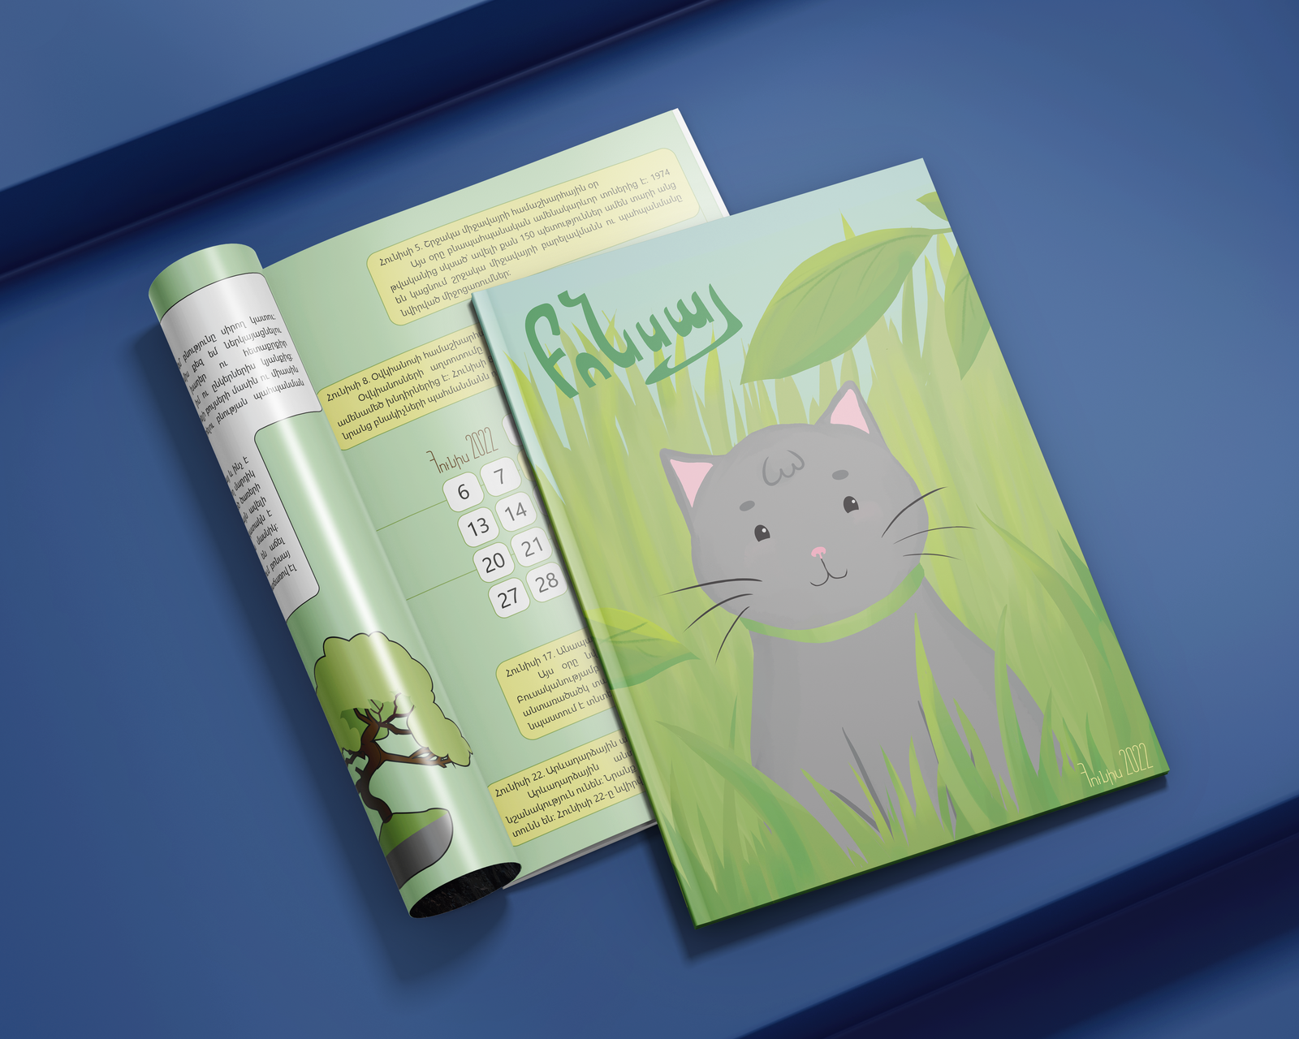
SONA AVAGYAN
"BONSAI"
CHILDREN'S MAGAZINE
CAPSTONE PROJECT PRESENTATION

Slide 2
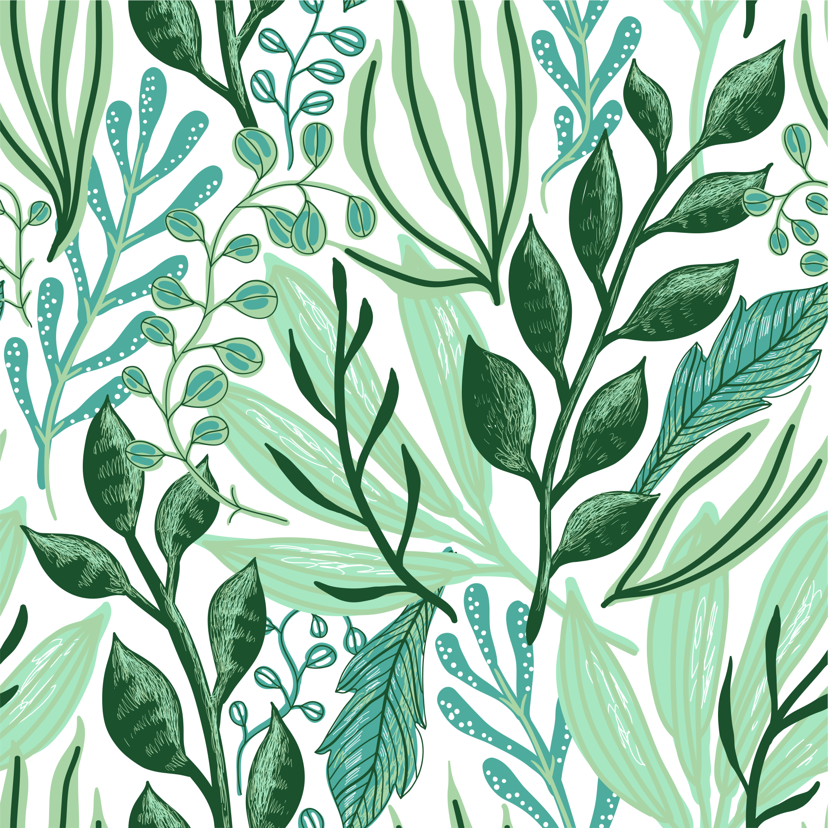
ABSTRACT
Having grown up reading and contributing to children’s magazines, made me fall in love with reading. With the rise of the popularity of the internet, many children are deprived of the experience of starting to read books, as video content has started to replace text and shorten the attention spans of consumers. This results in early anxiety to face long books.
My capstone project, a children’s magazine called “Bonsai,” aims to nurture a love for reading in Armenian middle schoolers. It concentrates on nature and the environment, emphasizing their importance and promoting a more eco-friendly lifestyle starting from a young age, while being entertaining and colorful to catch attention. The first issue of “Bonsai” has sections on environmental holidays, plants and their mythical origins, inspiring young people, ecotourism, and a fun personality quiz. The overall magazine tells stories and gives fun facts and tips about nature and the environment .
“BONSAI” IS THE FIRST STEPPING STONE INTO THE WORLD OF LITERATURE.

Slide 3
INTRODUCTION
WHAT IS "BONSAI"?
"Bonsai" is an environmental children's magazine. It teaches how important it is to care for the nature with stories and examples. The magazine also has sections dedicated to mythology and games.
WHO IS IT FOR?
Created for Armenian middle schoolers, the magazine's target audience are children aged 8-12 who can read in Armenian, as "Bonsai" is entirely written in Armenian.
WHERE IS IT AVAILABLE?
Currently, the magazine is only available in a digital format, but there are plans to print it in the future.
CLICK HERE TO READ "BONSAI"

Slide 4
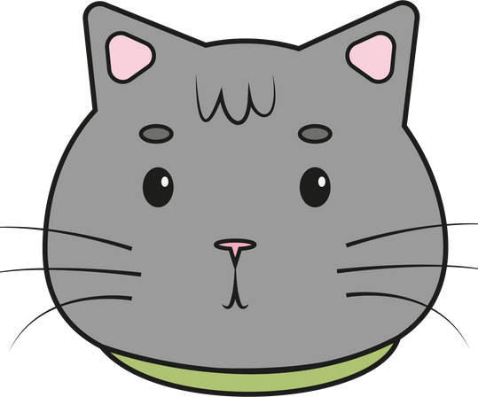
SECTIONS OF THE MAGAZINE
1
3
5
INTRO AND CALENDAR
ENVIRONMENTALIST
PERSONALITY QUIZ
An article about the young Armenian environmentalist Narek Ohanyan with some tips on being more eco-friendly.
This part introduces the mascot Bonsai and talks about the world environmental holidays in June.
A fun personality quiz that also gives some information about different types of trees.
2
4
MYTHOLOGY
ECOTOURISM
An article on the mythical origins of sunflowers and fun facts about them.
An article on ecotourism.

Slide 5
WHY IS IT IMPORTANT?
INTELLECTUAL REASONS
A decline in the popularity of reading and text media results in poor language skills, decrease of the attention span, and cultural ignorance (Wong, 2016).
MENTAL REASONS
The pressure of sufficient academic performance raises the reading anxiety levels and makes kids afraid of books (Ramirez et al., 2018).
ENVIRONMENTAL REASONS
Environmentally aware kids are more connected with their communities and value nature.

Slide 6
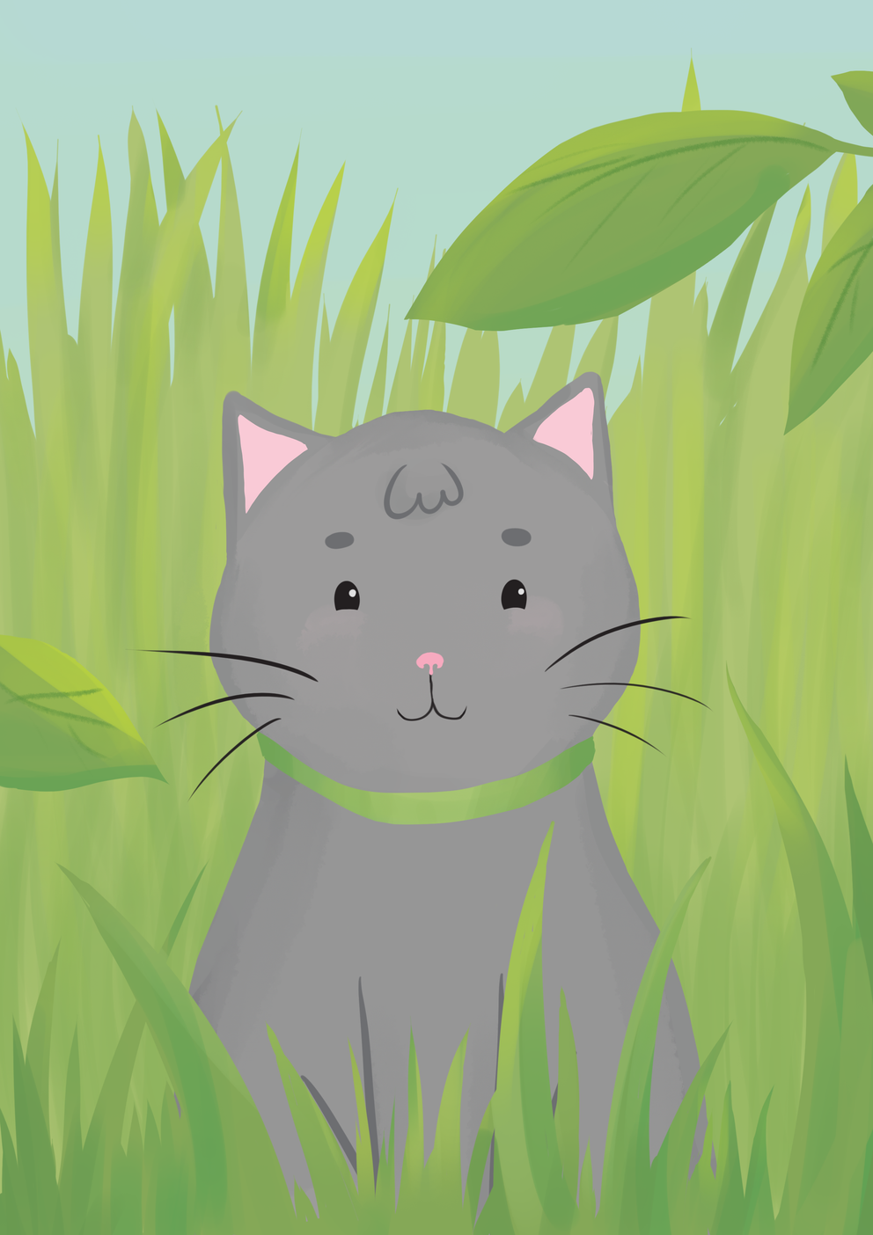
ALTERNATIVE EDUCATION
CREATIVE GOALS
My capstone project is, first of all, an alternative source of education for children that takes the anxiety of academic performance off their shoulders and presents a fun way of learning.
ENVIRONMENTAL AWARENESS
With the rising concerns for global warming prevention and environmental protection, it is crucial to teach children how to take care of our planet and cultivate eco-friendly habits from a young age.
LOVE FOR READING
My project aims to promote love for literature among children. Introducing articles in short bits, I hope to spark enough interest in my audience that some of them will pick up a book after reading the magazine.
ENTERTAINMENT
Finally, “Bonsai” provides children with healthy entertainment, free of stereotypes and potentially harmful content.

Slide 7
METHODOLOGY
MAGAZINES
INTERVIEW
I looked through children's magazines to get the idea how they are made.
I interviewed Narek Ohanyan for the article about himself.
WEB RESEARCH
DESIGN COURSES
A simple Google/Google Scholar search helped me with the articles.
I took graphic design courses, which helped me a lot with the layout of the magazine.

Slide 8
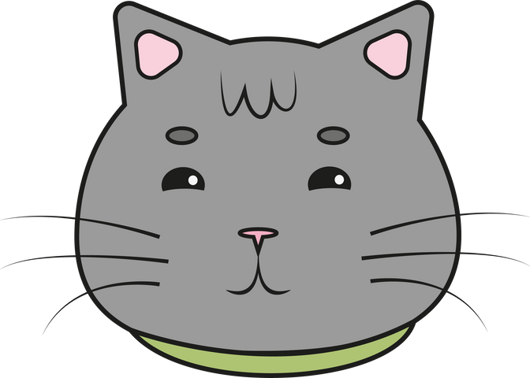
ARTIST STATEMENT
Growing up, I used to love children’s magazines. I sent them my stories and drawings, which would get published in the future issues. These magazines not only educated and entertained me but also nurtured my love for print media. The short articles and stories sparked my interest, making me want to read more. Although I had already started reading books, children’s magazines turned me into an avid reader.
After taking a Children’s Literature class in my junior year and making a book for the final project, initially I wanted to write an illustrated book for children for my capstone. Eventually, I realized a magazine would be an excellent choice, as it is less formal and covers more topics.
“Bonsai” teaches children to take care of nature and cherish it. It tells exciting stories from mythology and gives examples, showing that you are never too young to do something significant. It prioritizes fun in learning and breaks stereotypes by being about a small but capable cat who loves nature and outdoor activities. The magazine feels like a conversation: the text is written from the cat’s point of view, as if a friend is telling something to the readers.
The magazine “Bonsai” is my passion project because it includes my love for writing, illustrations, design, children’s literature, nature, and, of course, adorable cats.

Slide 9
REFERENCES
Brookshire, J., Scharff, L. F., & Moses, L. E. (2002). The influence of illustrations on children's book preferences and comprehension. Reading Psychology, 23(4), 323–339. Retrieved from https://doi.org/10.1080/713775287
Freedman, D. (1999). Writing for Children's Magazines. Underdown: The Purple Crayon. Retrieved from https://www.underdown.org/magazines.htm
Hayes, A. (2022). What video marketers should know in 2022, according to Wyzowl Research. HubSpot Blog. Retrieved from https://blog.hubspot.com/marketing/state-of-video-marketing-new-data
Ramirez, G., Fries, L., Gunderson, E., Schaeffer, M. W., Maloney, E. A., Beilock, S. L., & Levine, S. C. (2018). Reading anxiety: An early affective impediment to children’s success in reading. Journal of Cognition and Development, 20(1), 15–34. Retrieved from https://doi.org/10.1080/15248372.2018.1526175
Staniów, B., & Biernacka-Licznar, K. (2014). The press without children, children without the press: modern magazines for children in Poland. Toruńskie Studia Bibliologiczne, 6(2 (11), 49. Retrieved from https://doi.org/10.12775/tsb.2013.021
Wong, T.-kai. (2016, April 12). Not reading enough results in poor language skills, cultural ignorance, and fear of books. Young Post. Retrieved from https://www.scmp.com/yp/discover/lifestyle/features/article/3059235/not-reading-enough-results-poor-language-skills

Slide 10
THANK YOU!
BONSAI.NATURECAT@GMAIL.COM

