Slide 1
Information Literacy?
Transforming Armenia Into an Information Society
Capstone project by Sima Saroyan
American University of Armenia 2022

Slide 2
Outline
Introduction
Key terms and definitions
Research questions
Methodology
Research findings and analysis
Limitations and avenues for future research
Suggestions
Conclusion
References

Slide 3
Introduction
The purpose of this study is to present the formation of information society, to show the process of its development in Armenia, to point out the state's challenges, to highlight the current status of media literacy in Armenian society, and to examine state and public efforts to raise media literacy levels.
The last century was marked by the rapid development of the global information industry. Under the influence of scientific and technological progress, new means of information communication appeared. This led to the growth of the role of knowledge and technologies in public life. Also, the birth of the information society was noticed.
The importance of information literacy became significant. It enables proper orientation in the confusion of information flow, the correct evaluation of information, the use of safe and reliable sources, the creation of competent information flow of various dimensions and the effective protection against manipulative information.

Slide 4
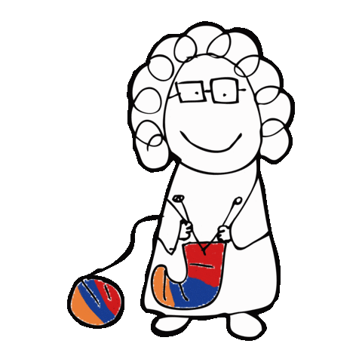
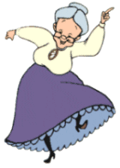
Introduction
In Armenia, however, the development of the information sector has its own peculiarity. At a time when the whole world was developing and funding in information society, breakthrough events were taking place in Armenia: the collapse of the USSR, Armenia's independence, regional conflict, and devastating earthquake
Hence while other countries where putting huge steps in the field of information society Armenia was just beginning its path to the unknown reality for it; called information society.
Armenia
Other countries

Slide 5
Key terms & definitions
Media Literacy - a set of skills that helps to use and consume media competently, critically analyze, create content, and communicate effectively through it.
Information Society - A post-World War II-era society in which the fields of speech, image, and display, are rapidly evolving in the economy. Knowledge is the primary economic resource here; most employees are more concerned with information, symbols, and images than material
Education - A process of nurturing and upbringing in the interests of the individual, society, and the state, aimed at preserving knowledge and passing it on to future generations.
State educational standard - a norm that defines the mandatory minimum content of academic programs, the maximum volume of the educational load of students, and the quality requirements for graduates.

Slide 6
Research questions
My capstone project's central research question clarifies how the Armenian education system might improve its information literacy teaching to help Armenians be more globally competitive. The other three secondary research questions that arise from this primary research question are:
1
2
3
Identify the causes of the state of information literacy in Armenia, comparatively examining the global and Armenian ways of establishing an information society
Examining the current state of the Armenian education system in the context of media literacy
Identifying opportunities to increase the level of information literacy in Armenia

Slide 7
Methodology
In my capstone I use qualitative research. It is a type of naturalistic inquiry that aims to learn more about social phenomena in their natural environment. It concentrates on the question "why" and is based on people's direct experiences. Hence I used 3 methods to conduct my research
The Descriptive method
01
The method helped demonstrate how the information society was formed
Causal-Comparative and Correlational methods
02
The method helped combine facts and make a comparative analysis
Interview method
03
The method helped to understand if pupils are actually studying information literacy skills

Slide 8
Research findings and analysis
Within the framework of the research, I conducted interviews with the following specialists:
Samvel Martirosyan, an Armenian media expert, information security specialist, and the host of the "Media Literacy" show on Armenian Public Television.
Media Literacy Program manager in Media Literacy Center, Executive Editor of Media Literacy Handbook, Co-author of Media Literacy Training Games, Media Expert Lusine Grigoryan
The Dean of the Faculty of Journalism of YSU, PhD, Associate Professor, Media Specialist Naghash Martirosyan,
Lusine Grigoryan, principal of school No. 61 in Yerevan (please note that I interviewed 2 Luisne Grigoryans),
Hasmik Movsisyan, a teacher at Echmiadzin School No. 10.
I sent a questionnaire consisting of four questions to the RA Ministry of Education, Science, Culture, and Sports (MoESCS) and received an answer.

Slide 9
Research findings and analysis
I studied
Legislative acts related to the topic
Some local and international reports
The manual "Media Literacy"
"Media Literacy" TV program
Armenianized computer games of media literacy and cyber security: "Media Battle," "Adventures of Literatus," "Tsantsar."

Slide 10
Conceptual, systemic approaches to building a media literate society
Government agencies have bilateral challenge in the context of educational development in Armenia
1
to build a media literate society
2
development of information technology and science
For the first issue In February 2021, the Government of the Republic of Armenia adopted Decision N 136-N, which amended the procedure for approving the State Standard for General Education of April 8, 2010. The new procedure defines eight competencies of secondary education, the 5th of which is called "Digital and media capacity." This clause states:
Some conceptual/legislative steps are being taken for both of the issues mentioned above. In particular, in connection with the second issue, by the decision of the RA Prime Minister on June 1, 2019, the goals of the RA Ministry of High-Tech Industry were defined

Slide 11
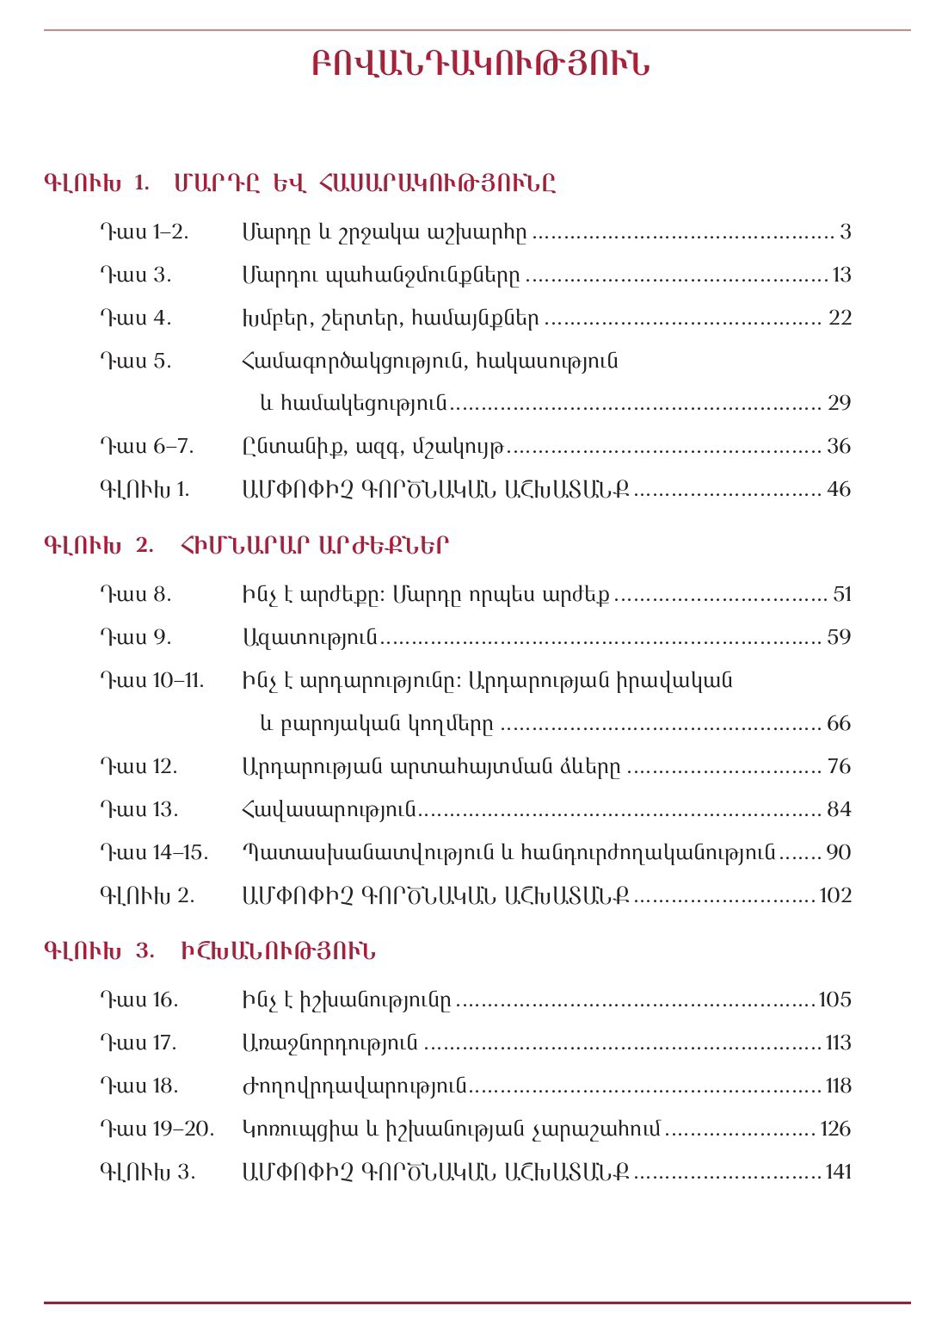
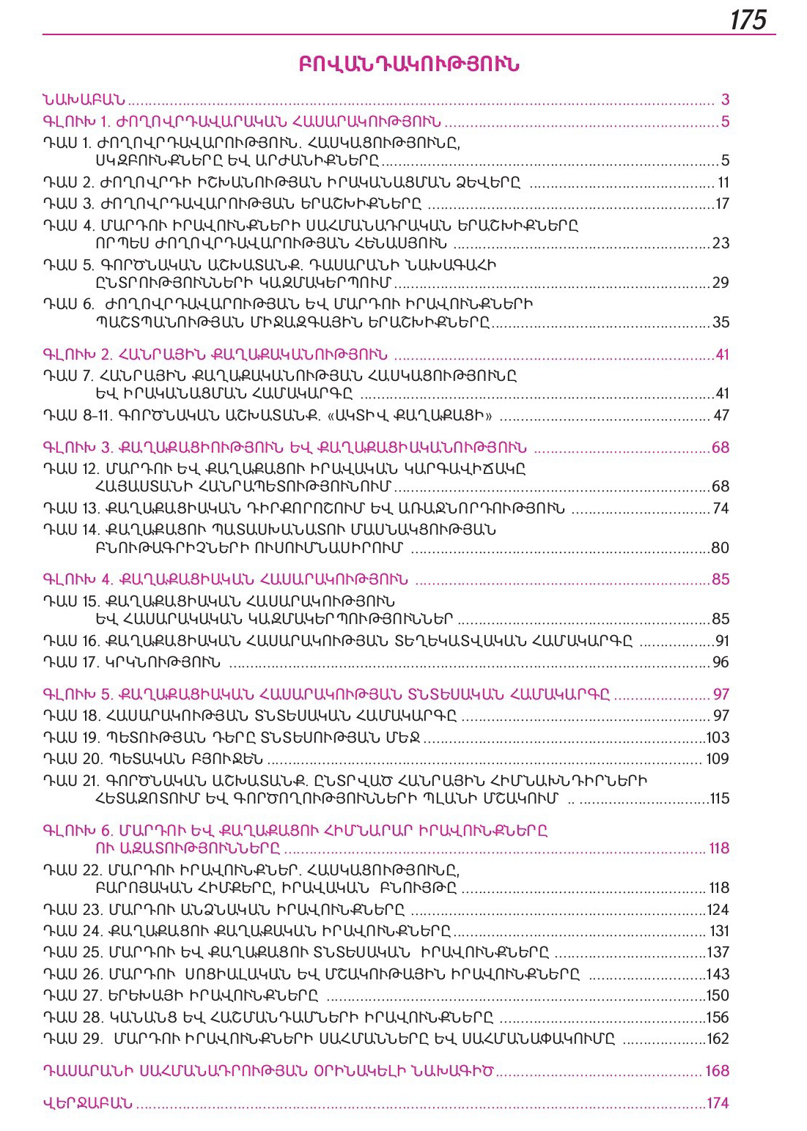
Against or for the sake of media literacy. Analysis of state-expert community cooperation
However there are some contradictions. For instance according to the ministry's statement, "media literacy is offered as a component of the integrated topic for grades 8-9 within the context of the "Social Science "subject.” However, my examination of the 8th and 9th-grade textbooks on the subject of "Social Science," showed that there are no direct topics related to media literacy in these textbooks. Below are the "Contents" sections of these textbooks
The MoESCS response to my inquiry
The content tables of the 8-9 grade "Social Science " subject textbooks

Slide 12
Against or for the sake of media literacy. Analysis of state-expert community cooperation
the state and the expert community try to cooperate and take special steps for the development of the media literate society
The Center for Media Initiatives envisions a specific program of lessons based on the materials in the "Media Literacy" manual, as well as the screening of video lessons, the holding of educational media games created by the center, meetings with journalists and center representatives, etc.
MoESCS informed that "the Ministry is working with a variety of organizations, with the motto 'Safe Internet,' to raise awareness of teens and their parents, to ensure their cyber security and protection." Representatives of non-governmental organizations and schools also attested their cooperation with the Ministry
However all these these are not imperative

Slide 13
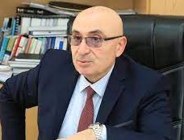
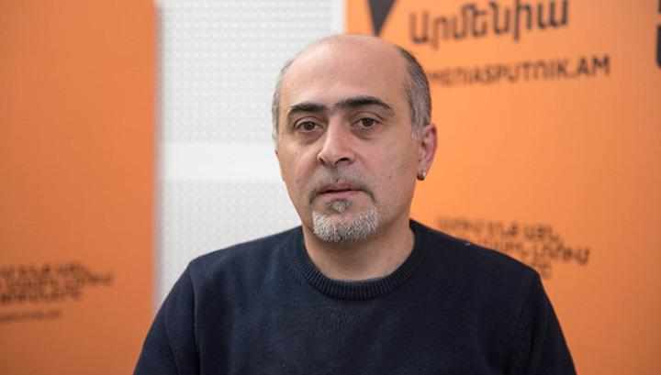
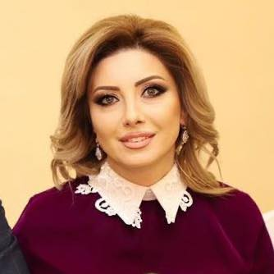
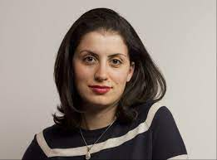
How much are Armenian pupils media literate? Analysis of expert information
Naghash Martirosyan, Dean of the Faculty of Journalism, stated that the problem is profound, and schools still have much to accomplish.
Samvel Martirosyan, in particular, stated that students' media literacy is inadequate and that they have limited opportunities to improve it.
Lusine Grigoryan, the head of the Media Literacy Program, stated that there had been considerable progress since 2010.
Lusine Grigoryan, principal of Yerevan School No. 61, and Hasmik Movsisyan, a teacher at Etchmiadzin School No. 10, pupils' media literacy levels vary. pupils are not particularly literate as information consumers.

Slide 14
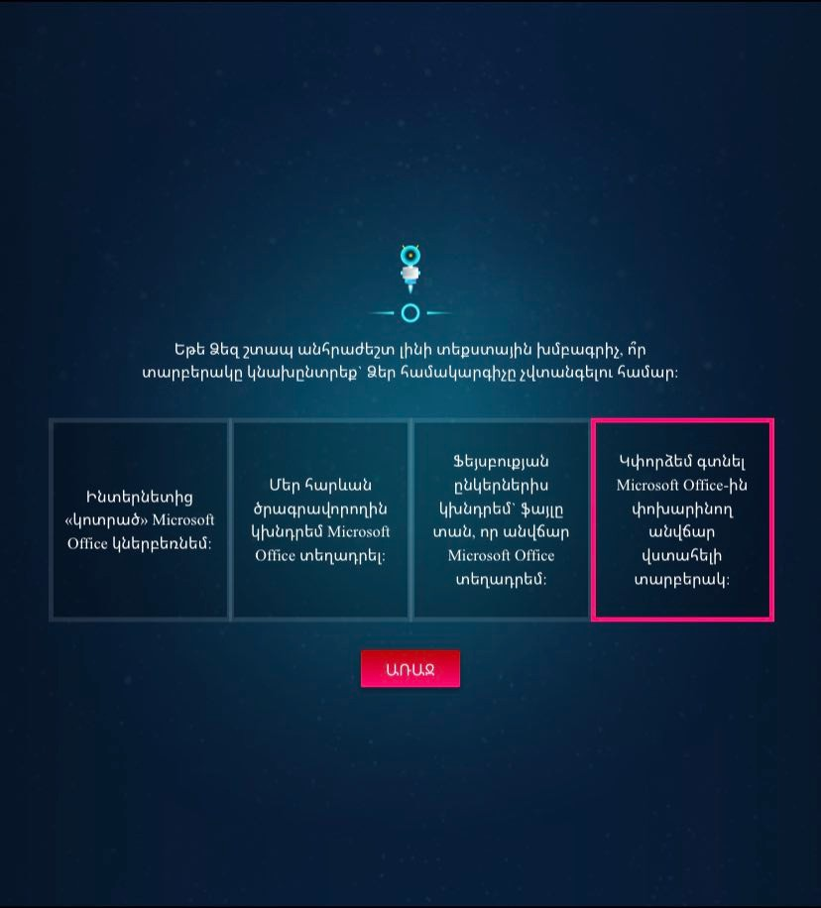
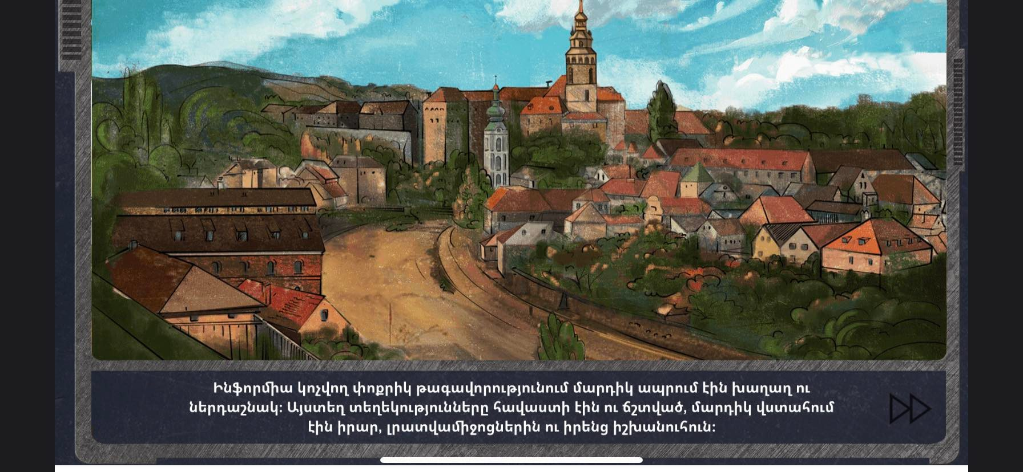
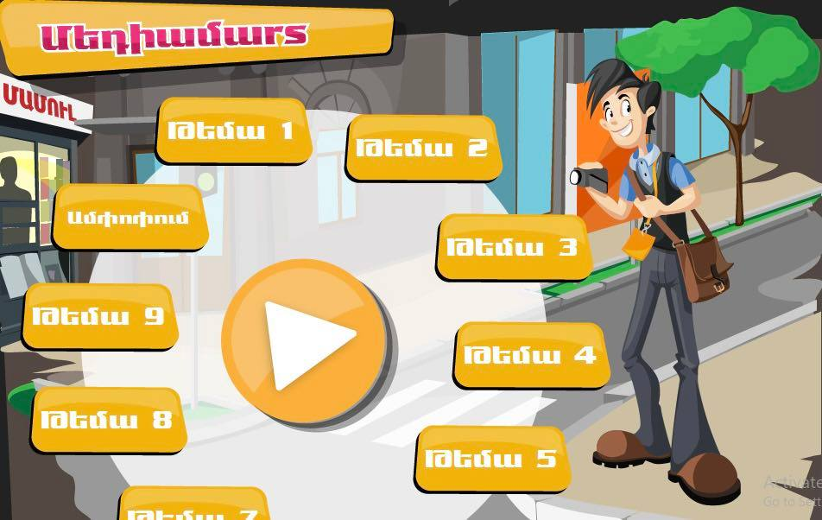
Media literacy tools outside of school or in parallel with school: A general overview
Games, programs and manuals were created to help the Armenian society become media literate
"Media Literacy" TV program
"Media Literacy" manual
"Tsantsar" game
"Adventures of Literatus'' game
"Media Battle” game

Slide 15
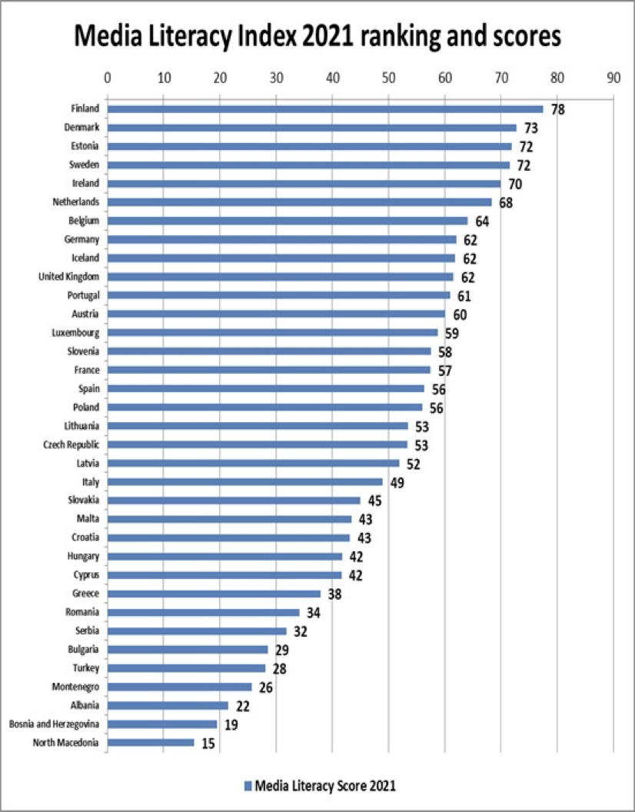
Media literacy in the world: A brief overview
2021 Finland (1st), Denmark (2nd), Estonia (3rd), Sweden (4th), and Ireland (5th) are the leaders in the media literacy index among 35 European countries. Finland leads the "Media Literacy Index 2021" list this year, as it has in prior years. The Open Society Institute's Sofia European Policy Initiative (EuPI) classification was based on the potential of 35 European countries to counter fake news.

Slide 16
Limitations and avenues for future research
It would be critical to conduct a large-scale public opinion poll in terms of field research. This would serve to define the society's information literacy, as well as the basic demands of pupils, from which the primary directions of the works aimed at spreading media literacy would be outlined.
The research could also include a separate, one-time study of events that are not directly related to media literacy but directly contribute to it.These events are usually manifested in the form of one-time seminars, meetings with journalists, and media exhibitions.They do not have periodicity, and their scope is always different.
Unfortunately, these were beyond the scope of this limited study; hence, a research group should deal with it.

Slide 17
Suggestions
In order to have a stable information society, state care for various fields of science is a priority. At the same time, the whole mechanism of science funding should be reconsidered.
At the state level, it is necessary to pay attention to the geography of information flows both internationally and domestically.
To make media literacy capabilities and outcomes appropriate to the new standards of general education, it would be better to outline certain mechanisms clearly.
The media industry must participate in the development of a media-literate community.
Finally, it would be right to introduce a course called "Media Literacy" in schools, which will be aimed at mastering the skills of using and consuming media competently, critically analyzing, creating, and communicating effectively through it.

Slide 18
Conclusion
The examination of the process of building an information society in Armenia and the current state of information literacy allowed me to draw some conclusions.
The development of the information society in Armenia is slow.
The Armenian general education system is now working to increase the media literacy level in the country.
There is no alternative to reforming general education in the context of media literacy.
However, even with the measures mentioned above, the goal of a media-literate society remains hazy, at least for the next ten years. The following are some of the reasons:
There is a personnel problem. Representatives of the training organization claim that many of the trained teachers do not have a good understanding of the basic principles of media literacy.
Any new norm does not take effect instantly, especially in the sphere of education, which is regarded as one of the most conservative.

Slide 19
References
lekseyeva I. (2009). What is a knowledge society? Moscow, Kogito-Center.
Retrieved from http://graduate.scmaiconf.ru/download/alexeeva_fin3.pdf
Arlis (Feb. 4, 2021). Decision N 136-N of the Government of the Republic of Armenia.
Retrieved from https://www.arlis.am/documentview.aspx?docid=149788
Arlis (Jule 10, 2009). The law of the Republic of Armenia on general education.
Retrieved from https://www.arlis.am/documentview.aspx?docid=71908
Arlis (June 5, 2019). Decision of the prime minister of the Republic of Armenia.
Retrieved fromhttps://www.arlis.am/DocumentView.aspx?docid=131156
Armstat.am (2019). Activities of general education institutions.
Retrieved fromhttps://armstat.am/file/article/sv_03_20a_5130.pdf
Bayadyan H., (March 25, 2009). Information security. Journal of Noravank Scientific-Educational Foundation, Yerevan Pp.31-34.
Retrieved from http://www.noravank.am
Bayadyan H., (March 25, 2009). New media and information society, "21st Century." Journal of "Noravank" Scientific-Educational Foundation # 3, Yerevan, Pp.3-21.
Retrieved from http://www.noravank.am/upload/pdf/21_Dar_2009_03.pdf
Cray J., Donabedian A. (2013). Critical Information Literacy and the Technology of Control: The Case of Armenia.
Retrieved from https://academicworks.cuny.edu/hc_pubs/275

Slide 20
References
Enterprise Incubator Foundation (2017). ICT sector in Armenia, research in the field of information and telecommunication technologies in Armenia.
Retrieved fromfile:///C:/Users/User/Downloads/2017-ICT-Industry-Report_arm-FINAL.pdf
European Commission/EACEA/ (2019). Digital education at school in Europe. Eurydice report. Luxembourg: Publications Office of the European Union
Retrieved from https://eacea.ec.europa.eu/national-policies/eurydice/sites/default/files/en_digital_education_n.pdf
Federov A. (2015). Media education: history & theroy.
Retrieved fromhttps://ifap.ru/library/book560.pdf
Ferrington, G., & Anderson-Inman, L. (1996). Media Literacy: Upfront and On-line. Journal of Adolescent & Adult Literacy, 39(8), Pp. 666–670.
Retrieved from http://www.jstor.org/stable/40015662
Fossey, E., Harvey, C., Mcdermott, F., & Davidson, L. (2002). Understanding and Evaluating Qualitative Research. Australian & New Zealand Journal of Psychiatry, 36(6), Pp.717–732.
Retrieved from https://doi.org/10.1046/j.1440-1614.2002.01100.x
Garnham, N. (2000). Information Society Theory as Ideology: a Critique. Key Words: A Journal of Cultural Materialism, 3, Pp.22–44.
Retrieved from https://www.jstor.org/stable/26920219
McNeill E. (Feb. 2021). U.S. media literacy policy update 2021, A state-by-state survey of the status of media literacy education laws for K-12 schools,
Retrieved fromhttps://medialiteracynow.org
Media.am (April,16,2020). Media literacy: manual
Retrieved fromhttps://media.am/hy/lab/2020/04/16/17917/
Osis. bg (March 14, 2021). Media literacy index 2021
Retrieved from https://osis.bg/?p=3750&lang=en

Slide 21
Thank You!

