Slide 1
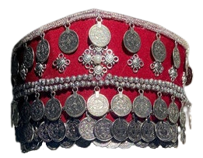
The Armenian Taraz
Anna Vardanyan
The Armenian taraz: How Armenian Women Around the Armenian Plateau Dressed by the Nineteenth Century
Presented to the
Department of English & Communications
in Partial Fulfillment of the
Requirements for the Degree of Bachelor of Arts
American University of Armenia
May 20, 2022

Slide 2
Introduction
The Armenian traditional dress — the taraz — has been around for millennia.
It has changed throughout centuries under foreign domination, ultimately, in the nineteenth and the first decade of the twentieth centuries, becoming the taraz we know today — after which it was not worn again by the Armenian masses.

Slide 3
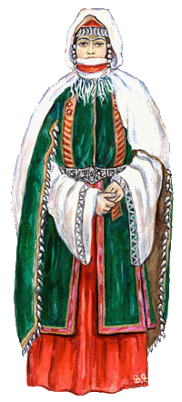
The elements that made up the taraz in every region were different, yet the basic components stayed the same, making the Armenian taraz, regardless of its regional belonging, unique and distinguishable from surrounding cultures’ traditional dresses.
As these elements are making a comeback into the modern Armenian world, the focus should be on not only fashion aesthetics, but largely on understanding and correct representation of what took centuries to form.

Slide 4
Research Questions
How has the taraz been a statement of identity for Armenian women?
How has the adaptation of foreign elements into the taraz impacted Armenian culture and the perception of a unique identity?

Slide 5
Methodology
Observation
Research
Interview
Visiting and noting visually observed elements as evidence
Using previously researched credible studies on the topic to buttress claims
Interviewing Lusik Aguletsi’s daughter, Astghik, on the life and work of her and her mother, as well as knowledge about the taraz

Slide 6
The Taraz:
Differences and Foreign Influences

Slide 7
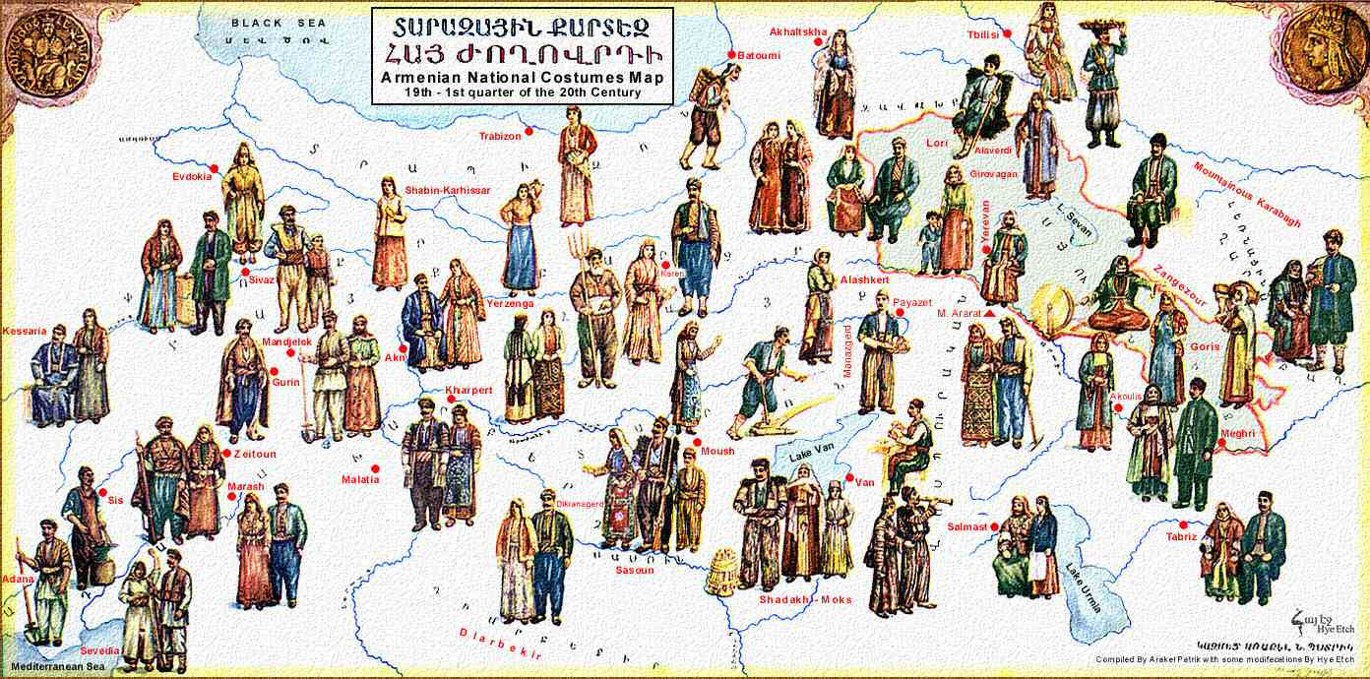
The Armenian Taraz of the Armenian Plateau

Slide 8
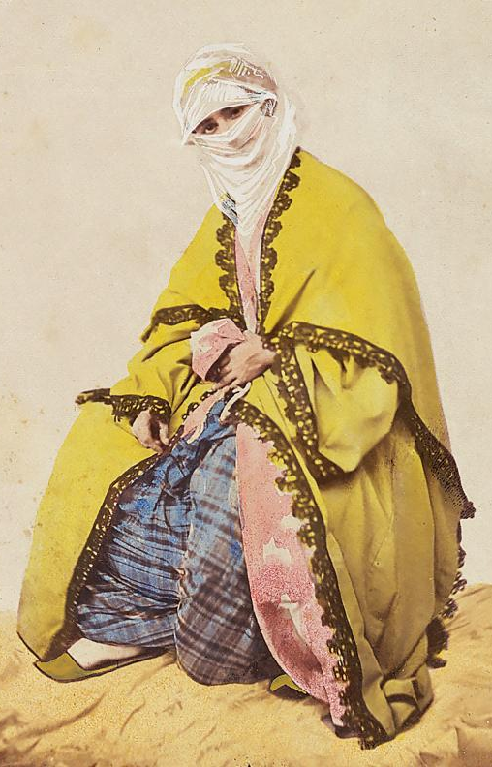
Ottoman Turkish
The use of shalwar (şalvar in Turkish) dates its origins back to the Turkic tribes that eventually founded the Ottoman Empire.
The shalwar remained common with Turkish women, and also spread to other minority groups because it was very practical.

Slide 9
Safavid Persian
A special garment called the khalat that was worn by the Persians influenced the regional dresses too — it is a robe-like garment worn on top of the underdress.
The Georgians integrated this element to their dress, and so did the Armenians — particularly in regions neighboring or under Safavid rule.

Slide 10
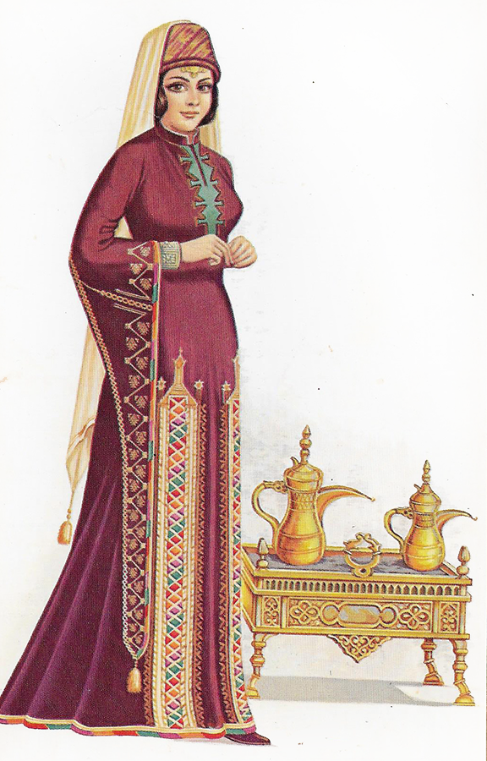
Levantine Arab
The Levantine Arab women often wore dresses that were rather sparkly, shiny, as well as sewn with gold threads and contained silk. Armenians who lived in regions neighboring the Arabs often adapted these details to their taraz too.

Slide 11
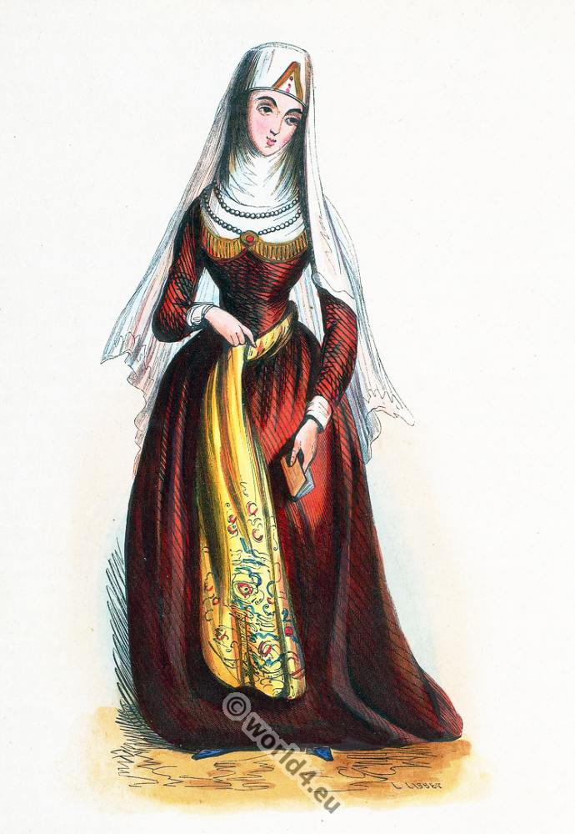
Georgian and North Caucasian
Georgian dresses often included an apron-like garment.
Hence, the tying of aprons in the Armenian taraz had its origins in the Caucasian and Georgian cultures north of the Armenian Highlands.

Slide 12
The Interview and Museum Observations

Slide 13
Aguletsi Museum
Lusik Aguletsi became one of the most interesting figures in the world of the Armenian taraz, who began wearing it during the Soviet Union, until her death in 2018.

Slide 14
Her research and knowledge of the taraz passed down the generations she left, who continue to spread her message, as well as revive the long-forgotten Armenian taraz and traditions.

Slide 15
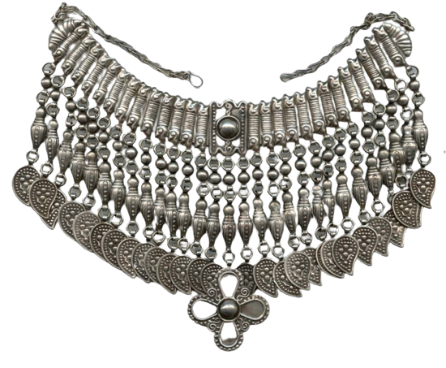
History Museum of Armenia
Museums in Armenia often have exhibitions that showcase the history of the Armenians, and in the case of this research, the exhibition attended was that of traditional ornaments, which are inseparable from the tradition of wearing the taraz.

Slide 16
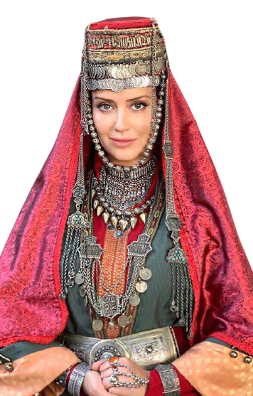
The Armenian Identity
The taraz is inevitably, form of cultural expression, which, by being unique, was part of the identity of the Armenians.
In the modern day, it is an element of Armenian identity that provides a sense of home for many who have lost the land and culture they once called home in Western Armenia.

Slide 17
References
Artac, B. Y. (2018). A Period Analysis on Values Shaped by Culture: Turkish and Armenian Women's Clothing. European Scientific Journal, 14(32), 131-153. doi:10.19044/esj.2018.v14n32p131 Retrieved from http://dx.doi.org/10.19044/esj.2018.v14n32p131
Kvantidze, G. (2016). The Khalat as a Gift and the Customs Connected to it in the Life of Eastern Georgia (Ilia State University). 133-157.
Khatcherian, N. E. (2015). Armenian Crafts in the Ottoman Empire: Cultural Exchange and Armenian Identity (Unpublished master's thesis). University of South Florida.
Munroe, N. H. (2008). Donning the Cloak: Safavid Figural Silks and the Display of Identity. Textile Society of America Symposium Proceedings.

Slide 18
Quataert, D. (1997). Clothing Laws, State, and Society in the Ottoman Empire, 1720-1829. International Journal of Middle East Studies, 29(3), 403-425. Retrieved from https://www.jstor.org/stable/164587.
Inal, O. (2011). Women's Fashions in Transition: Ottoman Borderlands and the Anglo-Ottoman Exchange of Costumes. Journal of World History, 22(2), 243-272. Retrieved from https://www.jstor.org/stable/23011711.
Gasparyan, G. (2018, November 30). Native: Costume. Retrieved from https://www.youtube.com/watch?v=pZqFBve7rq0&t=111s
Floor, W., & Clawson, P. (2000). Safavid Iran's Search for Silver and Gold. International Journal of Middle East Studies, 32(3), 345-368. Retrieved from https://www.jstor.org/stable/259513.
Patrik, A. (1983). Armenian National Costumes: From Ancient Times to Our Days. (D. S. Vardoomian, Ed.) (2nd ed.). Sovetakan Grogh.
Vardanyan, V. (2021). National Identity, Diaspora, and Space of Belonging: an Armenian Perspective. Gomidas Institute, London.

Slide 19
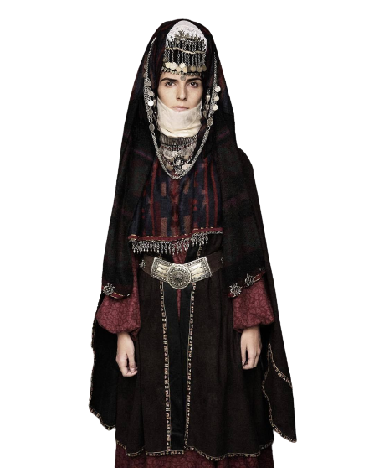
Thank you

