Slide 1
Street Fashion in Armenia
By Alice Arabian
Presented to the
Department of English & Communications
in Partial Fulfillment of the
Requirements for the Degree of Bachelor of Arts

Slide 2
Outline
01
02
03
Introduction
Methodologies
Research
Questions
04
05
Research
Findings
Conclusion

Slide 3
01
Introduction
Fashion is a very distinct form of communication. It is a form of self-expression through clothes, accessories, even hair.
It is one of the many methods that so many people use to communicate a certain message to someone, as the way one dresses can tell a lot about who they are and how someone else should perceive them. And, of course, with time, fashion changes and transitions, just like many other aspects of life.
This research explores the street fashion of Armenian women and some of the factors that have a major influence on it.

Slide 4
The history of fashion in Armenia
Prior to the twentieth century, the clothing in Armenia were rarely for aesthetic purposes, instead, they were meant to be functional.
The traditional Armenian clothing, also known as taraz, could tell a lot about a person, like their:
Marital status
Wealth
Lifestyle
Family
Nowadays, a taraz is used as a way to represent Armenian history and culture
Today, many young women add elements of the traditional Armenian taraz to their day to day style, which makes their style modern and traditional at the same time.
Many brands, like Pregomesh, are also trying to restore the Armenian traditional fashion in many ways, including jewelry.

Slide 5
02
Research Questions
What are some of the factors that impact street fashion in Armenia?
2. In what ways has social media affected young women’s fashion choices in Armenia?
3. What are some social issues that have had a role in affecting Armenian women’s street style?

Slide 6
03
Methodologies
Online Surveys
Focus Group
For this research the mixed method research (MMR) was used, which relies on both quantitative and qualitative research supporting one another.
And the two main methods that were used to achieve MMR were:
The participants were asked both open-ended and closed-ended questions about their thoughts and opinions on fashion, social media, self-expression, etc..
The participants were asked open-ended questions to start a much deeper conversation on topics such as fashion, social media, gender, and the correlation between them all.

Slide 7
04
Research Findings
There are three main factors that have an influence on the street fashion in Armenia:
Social media
Gender
Societal norms

Slide 8
Fashion & Social Media
Through the surveys it was evident that:
Most participants use social media as their main source of inspiration when it comes to fashion.
Social media influences people’s fashion choices whether directly or indirectly.
A lot of the change in style the participants had experienced goes back to social media.
Social media impacts the self-perception and self-expression of the participants as well.

Slide 9
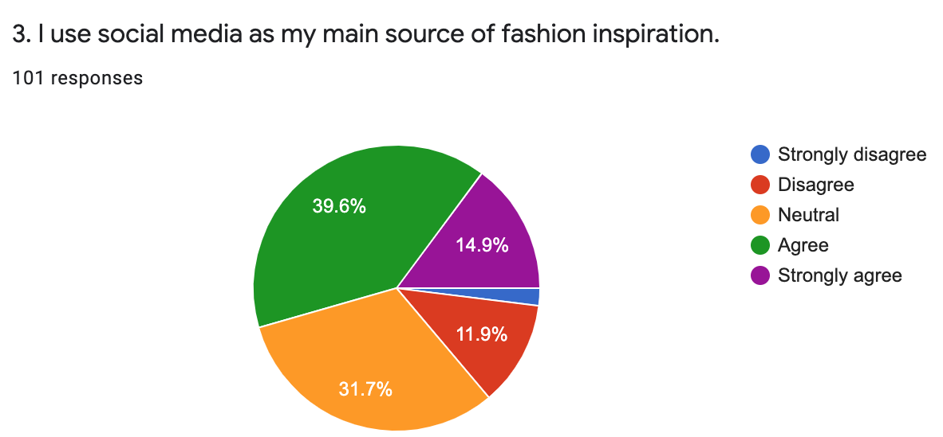
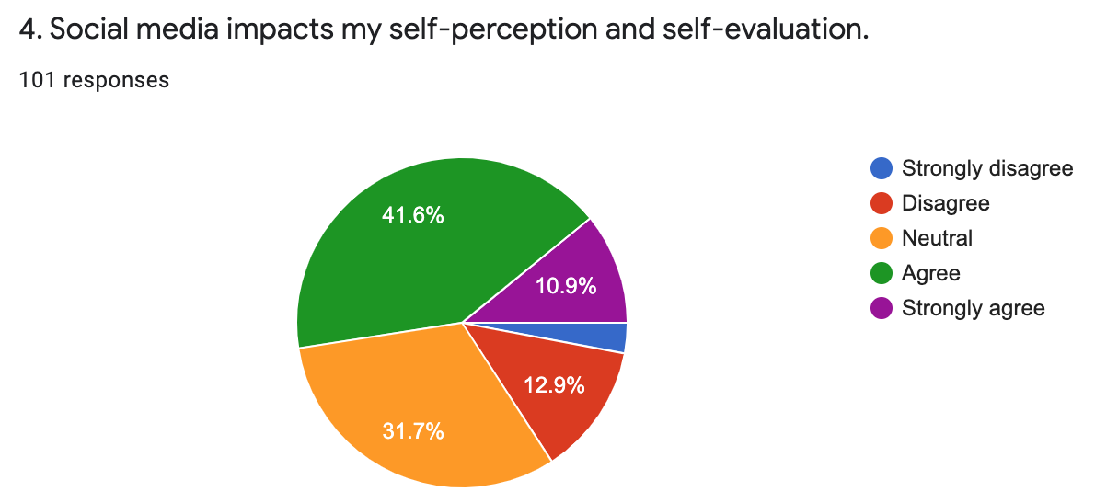
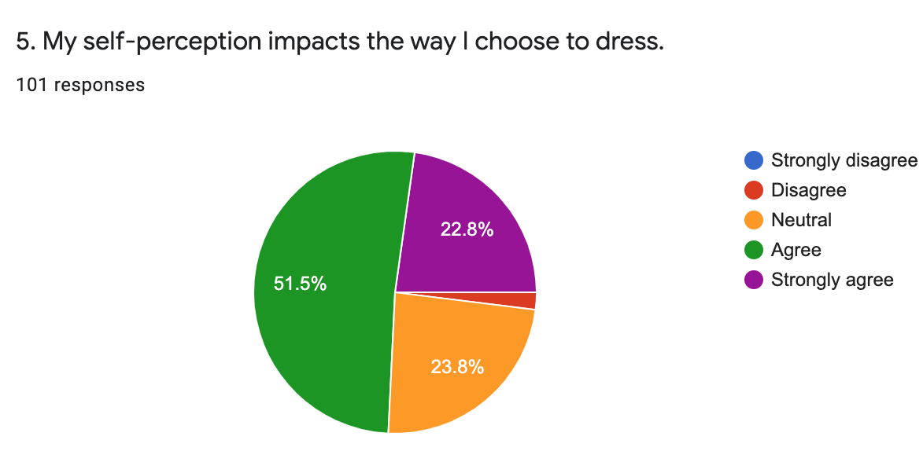
Fashion & Social Media

Slide 10
Fashion & Social Media
The correlation between social media and fashion became more significant especially during the Covid-19 pandemic.
Due to safety regulations a lot of people were forced to go on social media, and even online shops for their shopping and other needs.
Clothing brands shifted their attention towards social media, to keep contact with customers.
With the pandemic, other social media platforms boomed, such as TikTok.

Slide 11
Fashion & Social Media
With the connection between fashion and social media, there was also a significant difference between generation Y and generation Z in terms of their style. That is because:
Gen Z is more bold, expressive, and experimental with their fashion, and like to follow more trends, which they often see on social media.
Online stores are opening on social media, which are run by the younger generation. As they are able to find and follow the trends quickly, and bring them to the country through online shops as soon as possible.

Slide 12
Fashion & Gender
The research showed that there is a significant correlation between fashion and gender as well. A lot of the survey and focus group participants claimed that:
They sometimes restrict their fashion choices because they are women.
The male gaze has a huge impact on their day to day style.
There is also a correlation between “perfect beauty standards,” self-perception, and self-expression.

Slide 13
Fashion & Societal Norms
The research showed that societal norms have an impact on fashion as well.
Some of the participants claimed that they restrict their fashion choices to avoid being judged.
They also claimed that a lot of the judgement can stem from:
The age gaps between the various generations.
The fast changing trends that the older generation is not so used to.

Slide 14
Fashion & Societal Norms
Another important factor that has an impact on fashion is shame or “amot” in the Armenian society.
This can be anything that is frowned upon or disapproved by the society.
It stems from the fear and complex of expressing personal opinions, hence, shaming others is the other road to take.
It holds back creativity, freedom of expression, and diversity in fashion and many other fields as well.

Slide 15
05
Conclusion
Social media, gender, and societal norms are just a fraction of the factors that impact the day-to-day fashion in Armenia, but they were the most significant ones found during this research.
This research also serves as an acknowledgment that fashion is more than the clothes we wear every day, but it is a way of self-expression, communication, and identity.
Evidently, fashion also represents the much deeper issues we face in our everyday lives, whether that is gender or society, and the much needed steps we need to take to work on changing those issues.

Slide 16
Thank you!

Slide 17
References
Allwood, E. H. (2020, April 9). Billie Eilish hits accelerate. Dazed. Retrieved December 4, 2021, from https://www.dazeddigital.com/music/article/48631/1/billie-eilish-interview-dazed-springsummer2020-harmony-korine.
Cambon, L., Djouari, A., & Beauvois, J.-L. (2006, September). Social judgment norms and social utility. ResearchGate. Retrieved April 27, 2022, from https://www.researchgate.net/publication/232605742_Social_Judgment_Norms_and_Social_Utility_When_It_Is_More_Valuable_to_Be_Useful_Than_Desirable
Casparian, G. (2018, June 15). Armenian national dress - taraz. Tours in Armenia. Travel to Armenia in all seasons. Retrieved April 28, 2022, from https://armeniadiscovery.com/en/articles/armenian-national-clothes-taraz
Eddo-Lodge, R. (2014, July 7). Women everywhere have their movement limited by the male gaze. openDemocracy. Retrieved April 28, 2022, from https://www.opendemocracy.net/en/5050/women-everywhere-have-their-movement-limited-by-male-gaze/
Garbis, C. (2013, December 8). Armenia's "amot eh" complex - living in shame. Hetq.am. Retrieved April 28, 2022, from https://hetq.am/en/article/31266
Hallgren, C., & Johansson, Y. E. (2021, June). The effortless fashionista: A Study of Lead Consumers Production of Subjectivities Through the Adaptation of Fast Fashion on Instagram. Lund University. School of Economics and Management. Retrieved October 31, 2021, from https://lup.lub.lu.se/student-papers/record/9061558/file/9061601.pdf.
Jiratanatiteenun, A., Mizutani, C., Kitaguchi, S., Sato, T., & Kajiwara, K. (2012, December 13). The transformation of Japanese street fashion between 2006 and 2011. Advances in Applied Sociology 2012. Vol.2, No.4, 292-302. Retrieved October 29, 2021, from https://www.scirp.org/html/25689.html.

Slide 18
Kim, M. (2021). Green is the New Black: The E een is the New Black: The Effects of CO ects of COVID-19 on the F VID-19 on the Fashion Industry’s Need for Sustainability. [PDF file] Retrieved April 27, 2022, from https://repository.upenn.edu/cgi/viewcontent.cgi?article=1109&amp;context=joseph_wharton_scholars
Koetsier, J. (2021, June 30). Massive Tik Tok growth: Up 75% This year, now 33x more users than nearest direct competitor. Forbes. Retrieved April 28, 2022, from https://www.forbes.com/sites/johnkoetsier/2020/09/14/massive-tiktok-growth-up-75-this-year-now-33x-more-users-than-nearest-competitor/?sh=2bfa814fe46b
Lea, C., Malek, P., & Runnvall, L. (2018, May). Influencers impact on decision making among generation Y and Z Swedish females when purchasing fast fashion. Jönköping University. Jönköping International Business School. Retrieved October 31, 2021, from http://www.diva-portal.org/smash/get/diva2:1214227/FULLTEXT01.pdf.
Leavy, P. (2017). Research design: Quantitative, Qualitative, Mixed Methods, Arts-Based, and Community-Based Participatory Research Approaches. The Guilford Press. Retrieved March 13, 2022, from https://b-ok.asia/book/3367988/066698
Lee, Y., & Kim, Y. (2005). Gender Identity Expressed in Contemporary fashion. The Research Journal of the Costume Culture. 13. [PDF file]. Retrieved October 31, 2021, from https://www.koreascience.or.kr/article/CFKO200436036090604.pdf
Michaela, E., & Orna, S. L. (2015, December). Fashion conscious consumers, fast fashion and the impact of social media on purchase intention. Academic Journal of Interdisciplinary Studies. Vol. 4 No. 3 S1. MCSER publishing. Retrieved October 31, 2021, from https://www.mcser.org/journal/index.php/ajis/article/view/8365.
OC Media. (2021, May 18). No laws, just shame: Sexual harassment in the South Caucasus. OC Media. Retrieved April 28, 2022, from https://oc-media.org/features/no-laws-just-shame-sexual-harassment-in-the-south-caucasus/

Slide 19
Omar, B. & Dequan, W. (2020). Watch, Share or Create: The Influence of Personality Traits and User Motivation on TikTok Mobile Video Usage. International Association of Online Engineering. Retrieved October 30, 2021 from https://www.learntechlib.org/p/216454/.
Pregomesh. (n.d.). About pregomesh online store. Pregomesh. Retrieved April 28, 2022, from https://pregomesh.com/pages/about-us
Revlon-Chion, E., Bolat, E., & Liang, Y. (2020, May 18). Instant buying of fast fashion: Are influencers to blame? Bournemouth University Research Online [BURO]. Retrieved October 29, 2021, from http://eprints.bournemouth.ac.uk/34010/.
Sarina. (2021, October 19). History of fashion - A brief story of the evolution of fashion. Sew Guide. Retrieved December 4, 2021, from https://sewguide.com/evolution-of-history-of-fashion/.
SKOMP, E. (2003). Misogyny, the Male Gaze, and Fantasies of Female Death: “Eto ia, Edichka and Russkaya krasavitsa.” New Zealand Slavonic Journal, 137–142. http://www.jstor.org/stable/40922148
Tiggemann, M., & Mcgill, B. (2004). The Role of Social Media Comparison in the Effect of Magazine Advertisements on Women’s Mood and Body Dissatisfaction . Journal of Social and Clinical Psychology, Vol. 23, No. 1, 2004, pp. 23-44. Retrieved October 29, 2021, from https://guilfordjournals.com/action/showCitFormats?doi=10.1521%2Fjscp.23.1.23.26991.
Vanbuskirk, S. (2021, September 11). What is the male gaze? Verywell Mind. Retrieved April 28, 2022, from https://www.verywellmind.com/what-is-the-male-gaze-5118422

