Slide 1
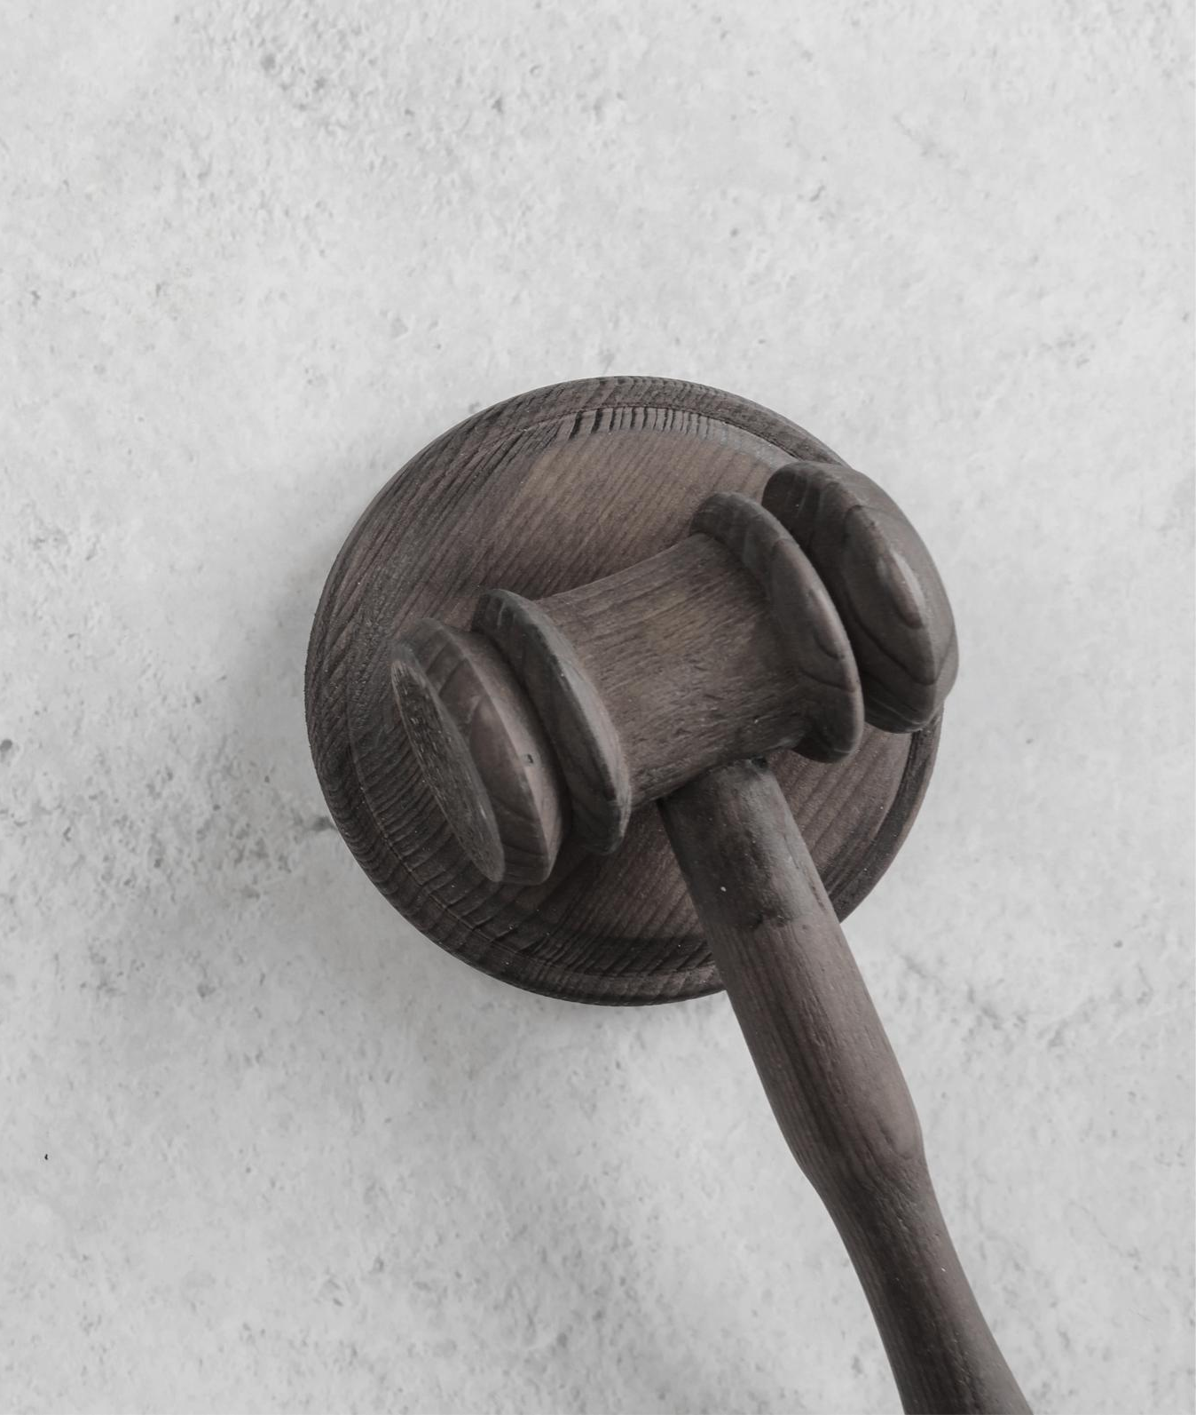
RHETORIC UTILIZED BY ATTORNEYS TO
ACHIEVE SUCCESS IN THE COURTROOM
Varsik Sabina Kazarian
Department of English & Communications
American University of Armenia
Yerevan, Armenia
Spring 2021

Slide 2
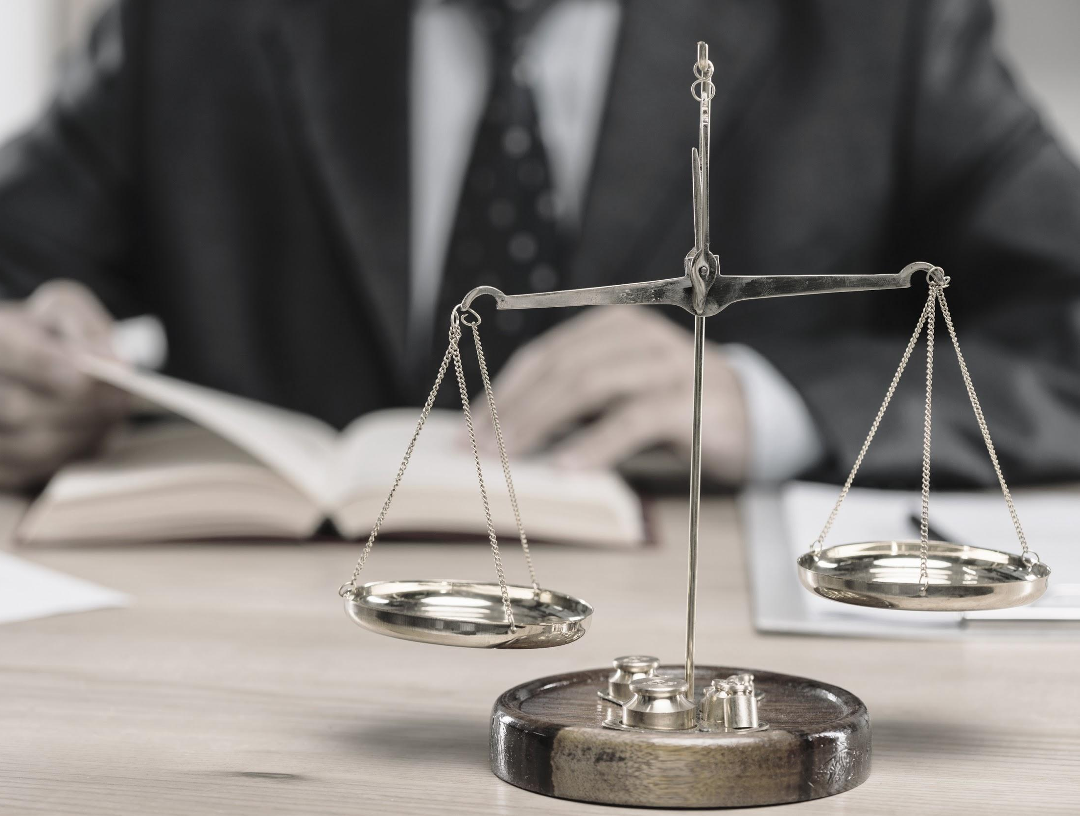
Outline
Introduction
Research Questions
Methodology
Research Findings and Analysis
Avenues for Future Research

Slide 3
Introduction
It is said that a skilled attorney will be able to effectively communicate across cultures, languages and legal systems - as long as they deftly utilize rhetoric. The modern meaning of rhetoric includes both verbal and nonverbal communication tactics of persuasion. Attorneys from the United States and Armenia were interviewed to thoroughly research and analyze how they utilize these powers of persuasion to obtain trust and compliance; or in other words, success in the courtroom. As courts in the United States and Armenia differ from one another in all three components mentioned above, the project will also highlight the differences between the two sets of attorneys’ rhetorical tactics.

Slide 4
Research Questions
Main Question: How do attorneys utilize rhetoric in the courtroom to achieve success?
Subsequent Question: What are the differences between the rhetoric utilized in the courtroom by attorneys in Armenia and those in the United States?

Slide 5
Methodology
Interviewed 5 attorneys from Armenia and 5 attorneys from the U.S. (greater Los Angeles area)
Each set included:
A prosecutor
Males and females
Attorneys with different specializations
Attorneys of various ages/years of experience

Slide 6
Interview Questions
How do you prepare arguments for court? What tactics do you undertake? Do you consider what rebuttals you may face and how you should refute them? Do you consider what rhetoric the other attorney may use? If so, how does that affect your use of rhetoric?
What type of rhetoric do you believe is most beneficial when trying to reach and persuade a judge and jury? Why do you believe so? Can you provide examples of instances?
How has your use of rhetoric changed from the beginning of your career versus now? What is something you weren’t aware of in the beginning of your career that you utilize now as far as achieving success in a courtroom by the means of rhetoric?
Does the field of law of a given case affect the rhetoric you use in court? Can you provide examples of how it may differ from field to field?
Do you adjust your rhetoric based on your familiarity with a judge/a judge’s reputation?

Slide 7
Research Findings and Analysis

Slide 8
Defining the three appeals in the courtroom
Pathos - emotional appeals
Logos - utilizing logic, facts and citing the law
Ethos - appealing to authority with precedents
*Because citing the law is commonly paired with presenting precedents, logos and ethos are often intertwined*

Slide 9
QuestioN 1
Similarities:
Legal research to cite laws and precedents
Differences:
U.S. attorneys mainly rely on case law to predetermine arguments while Armenian attorneys also rely on familiarity with opposing counsels

Slide 10
QuestioN 2 - differences
QuestioN 2 - Similarities
Armenian attorneys must solely persuade a judge while U.S. attorneys must also persuade a jury
Armenian attorneys underlined various approaches (i.e. manner of speech, choice of appeal, how to address a judge) for different judges while U.S. attorneys solely cite law and precedent to judges in a concise manner
For jury (during trial and jury selection), attorneys speak longer and use more pathos (i.e. relatable jokes and analogies)
Prosecutors felt a duty to persuade the public to maintain trust
Dress formally and in muted tones
Always portray respect to judges (i.e. standing when addressing them)

Slide 11
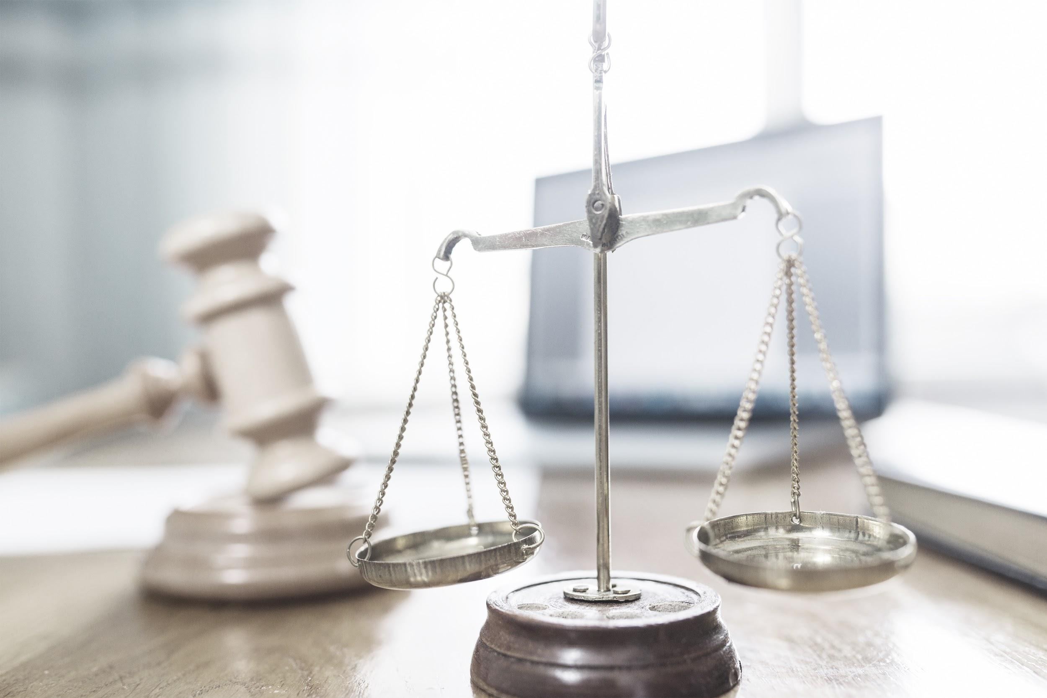
QuestioN 3
Having and portraying calm demeanors
Being implicit when undermining opposing counsel
Arguments are much more persuasive and engaging when memorized
Using rhetoric to really connect with audiences

Slide 12
QuestioN 4
Distinct psychology and parties in every given field of law require different rhetorical tactics:
Each field of law calls for different sets of vocabulary (“buzzwords”)
Words have different meanings in different types of laws
Various appeals can and should be applied to different fields of the law to achieve success

Slide 13
QuestioN 5 - differences
QuestioN 5 - Similarities
Most attorneys in Armenia use their familiarity with judges to adjust rhetoric (very slim amount utilize HelpCourt.Am) while it’s less common for U.S. attorneys to know judges (most use TheRobingRoom.com)
Judges in the U.S. have rules for their own courts and attorneys must oblige by them (i.e. a female may exclusively enter court with a skirt suit)
*Included websites allow for judges to be rated and reviewed by attorneys for other attorneys’ reference*
After point of familiarity, attorneys will calculated adjust their rhetoric to win favor with the judge (i.e. if a judge is more conservative, attorneys should
avoid utilizing electronic devices in court;
be more formal in their communications;
make arguments that are aligned with their values;)

Slide 14
Avenues for Future Research
SAMPLE SIZE
Locations
While I conducted five interviews within each group of attorneys and they provided me with great content, a broader selection would result in many more unique perspectives and a better understanding of the intertwinement between the legal system and the field of rhetoric.
While the U.S. group was solely attorneys from the greater Los Angeles area; each state has its own legal systems, customs and best practices of rhetoric to achieve success in the courtroom. The work would truly be rounded out if a few attorneys from each state were interviewed as well.

Slide 15
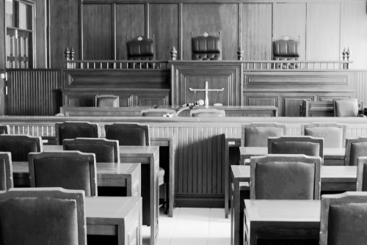
Thank you!

