Slide 1
SOCIO-PSYCHOLOGICAL PROBLEMS OF ADULT AND TEENAGE INSTAGRAM USERS| STOPPING THE ADDICTION IN FAVOR OF MENTAL HEALTH
Capstone project by anna papyan

Slide 2
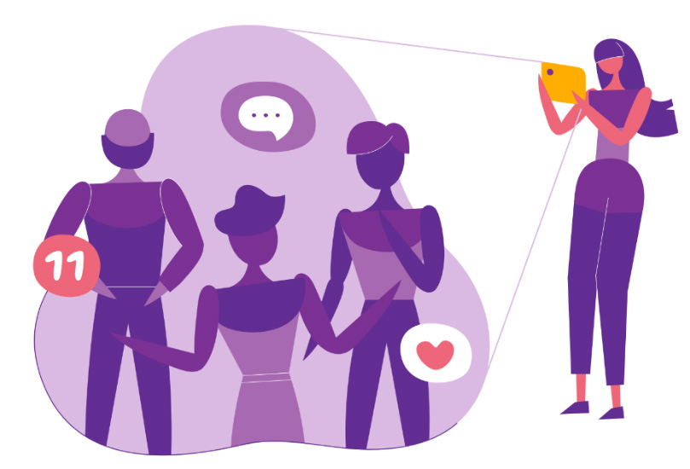
Why is this important?
The relevance of this work lies in the fact that in our time, dependence on social networks is becoming an epidemic and this problem undoubtedly needs to be addressed. The relevance of this topic is also due to the rapid development of social networks aimed to shape a social image.
The purpose of this work is to study the impact of one of the most powerful and influential social media platforms, Instagram, on the psychological health of teenagers.

Slide 3
Research question
?
This study is going to determine how does Instagram affect young adult’s psyche and what are the negative effects of Instagram exposure. Based on the analysis of psychological literature, the study is willing to discover what methods of psychological confrontation of the issue exist that can be practiced in order to achieve mentally healthier individual life.
?

Slide 4
contribution
Taking into account all the studied material and analyzing the methodological approach of existing research, this work seeks to identify possible manifestations of depressive or self-objectionable behavior by the method of experiment. This work will try to study the psychological behavior of a person who has abstracted from his comfort zone, which he considered the social network Instagram. Such temporary rejection of the usual routine and habitual social behavior of the individual in the social network will help to look at changes in psychological behavior in more detail and see what Instagram fasting would change in the psychology of people.

Slide 5
What are the functions of Instagram?
Share photos and videos: visual content is the fastest and easiest way to present oneself, and one’s virtual image.
Write captions: captions include everything, from personal opinion to advertisements.
Communication: Messaging with friends
Content sharing: sharing your interests, lifestyle with others, and viewing other people’s content.
Marketing: Instagram marketing is an opportunity to create a showcase for your product, position your company, store, restaurant, and any product or service that people demand and to promote it.
Instagram is one of the main tools for forming public opinion in the modern world. Rapidity is the main tool of Instagram, the feed Is usually scrolled fast. Thus it is important to make an impression on your followers or potential clients with beautiful posts.

Slide 6
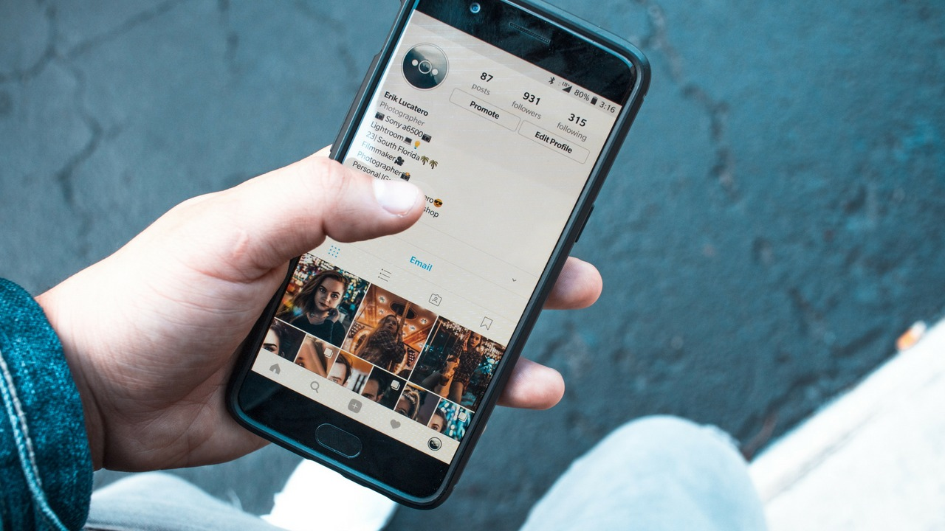
The danger of Instagram
The danger of Instagram (and other social media platforms too) is not in what people consume, but rather in what they create, which is the persona. the main problem arises when people become attached to that persona, it becomes a constructed identity. People carefully pick out fragments of their life and put on a display to make oneself appear in a certain way.
Instagram users might feel unhappy because of the sacrifices they make to promote their identity.
The kind of dependence on the reaction of others, especially strangers, leads to misery.
curating an identity limits people. They have taught themselves that they need to be a certain way on social media.

Slide 7
Social hierarchy
the problem of modern days is that social media has made human brain to think that he is competing against extremely successful people, it believes that there are extremely wealthy, fit and popular people who surround them. The brain believes this because of the amount of time people spend on social media and the content they expose themselves to. A recent study found that the average teenager is spending around six to nine hours on social media every single day (El Khouly C, Lockhart Marisa). Instagram is filled with millions of perfection embedded photos, filtered and photoshopped. People start to feel frustrated, as if they are at the bottom of the social hierarchy pyramid.

Slide 8
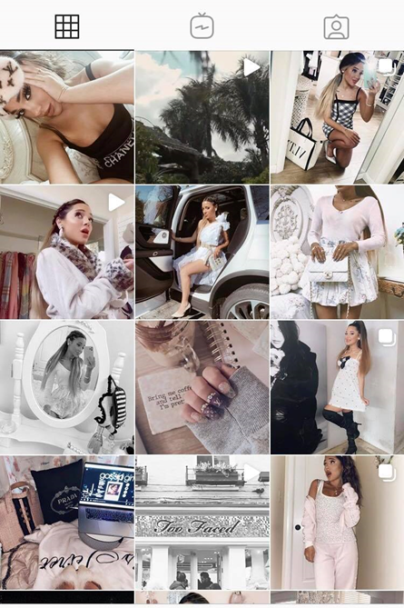
On one side Luxury, fashionable, dream like, style, wealthy, healthy looking, expansive,
ON THE OTHER SIDE
HIGHLY EDITED, FILTERED, COLOR CORRECTION, CAREFULLY CHOSEN LOCATIONS, EFFICIENT POSES AND ANGLES, SELECTED OUTFITS.

Slide 9
The truth is
if one is constantly surrounded with virtual (perfected) reality, they start to perceive it as the actuality, as instagrammers force you into thinking you have to compete against them.
Facts: No one is happy every single second of their day, as their pictures will like to have you believe it, and that is why social media platforms like Instagram are ruining ones’ life.

Slide 10
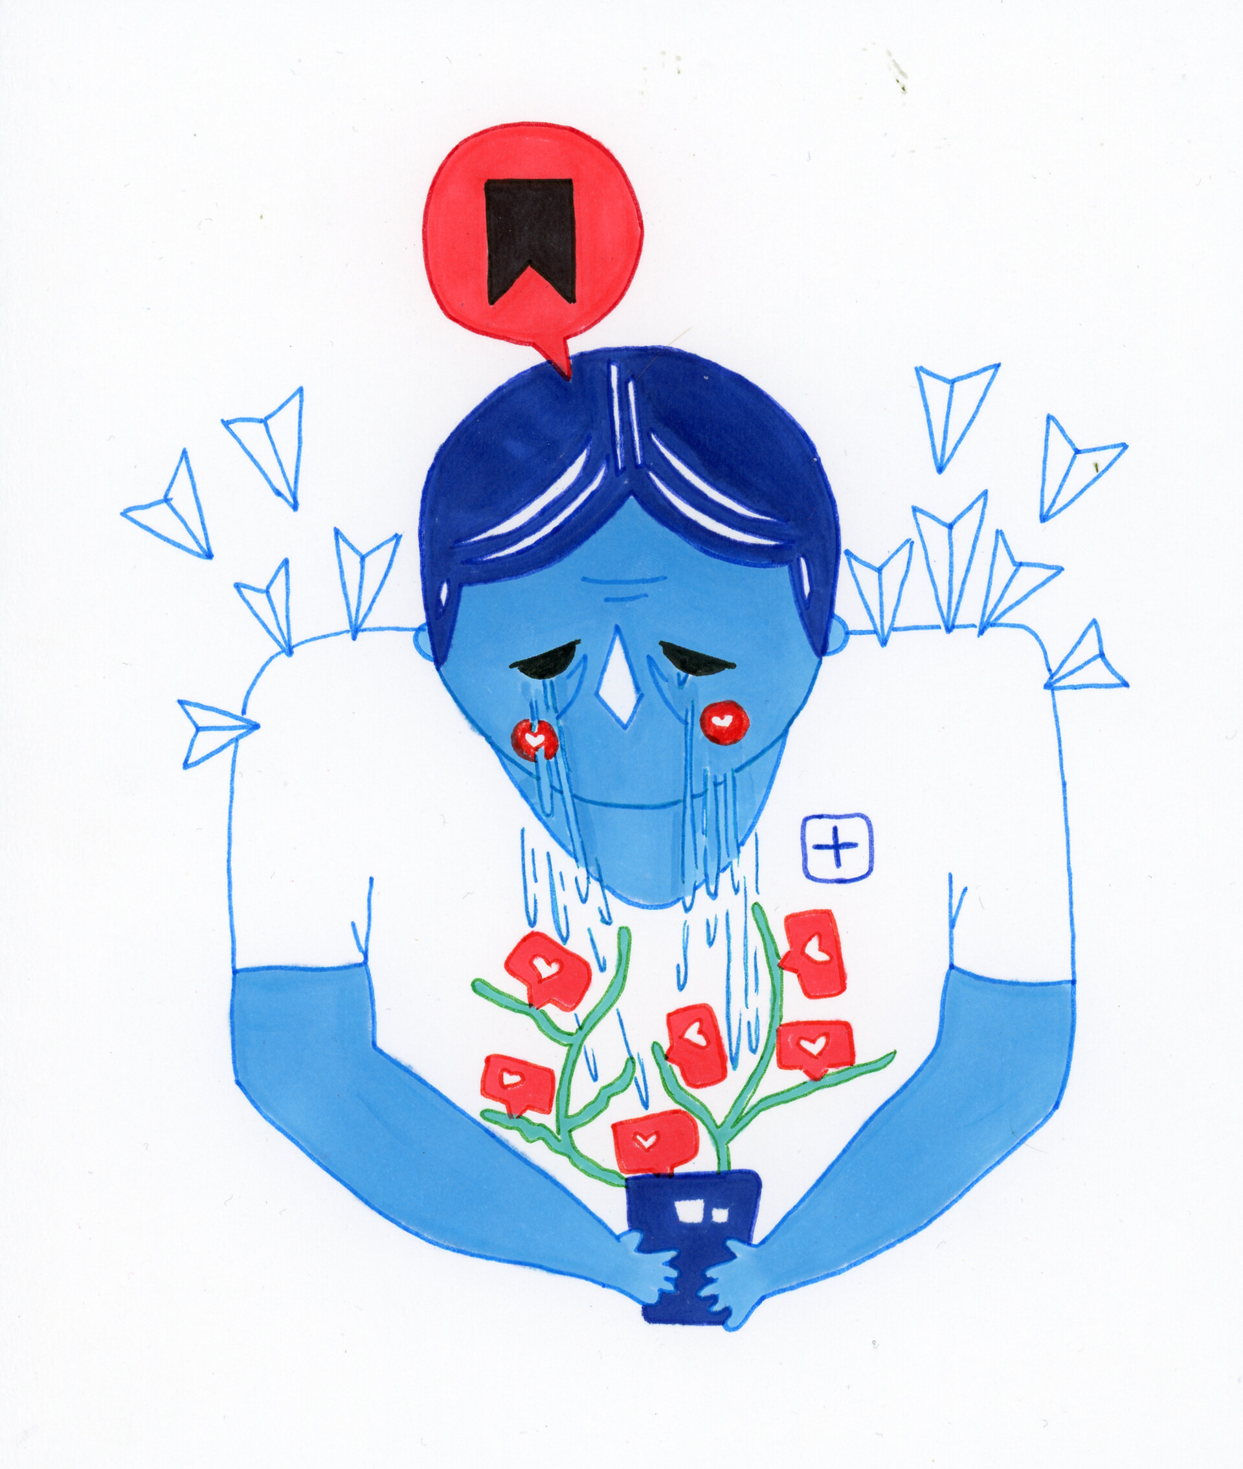
Instagram may…
Lower Self esteem: in young people is strongly related to their peer relationships, “particularly those who link their self-worth with the approval of others.” (Dewall, 2011). the constant pressure of being “socially accepted” leads to low self-esteem, and on Instagram, photo sharing, liking and commentaries can be a huge determining factor in one’s confidence.
Cause depression: This constant comparison of lives elicits negative feelings similar to jealousy that leads to depression.
Makes one feel lonely: people miss out on real life interactions. The fact of them being consumed with the cyber world has led to the feelings of loneliness. Social life, in fact, makes people feel isolated, detached and abstracted from the real world as much as it is possible.

Slide 11
methodology
Stage 1-research and investigative work, including searching for information in reference books and the Internet.
Stage 2-generalization of the acquired material.
Stage 3- conducting an experiment
Stage 4- conducting a survey.
Stage 5- binding the results of the work.
Stage 6- quantitative and qualitative analysis of the results obtained during the diagnosis

Slide 12
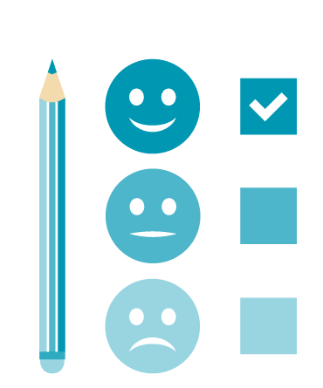
survey
20 questions
70 answers
Aim- to measure participant’s level of Instagram usage, as well as influentially of the app on individuals.
Question examples
When do you use Instagram most often?
Do you feel addicted to Instagram?
Do you feel pressure from Instagram?

Slide 13
experiment
Age group- 15-25
12 participants
Purpose- via conducting an Instagram fasting to reveal possible changes in psychological condition.
Based on Instagram fasting
Instagram fasting implies people becoming disconnected from the app for a certain period of time.
Conditions-should have an Instagram profile, relatively active exploitation of it,
Limitations-refusal of some people to participate due to incapability

Slide 14
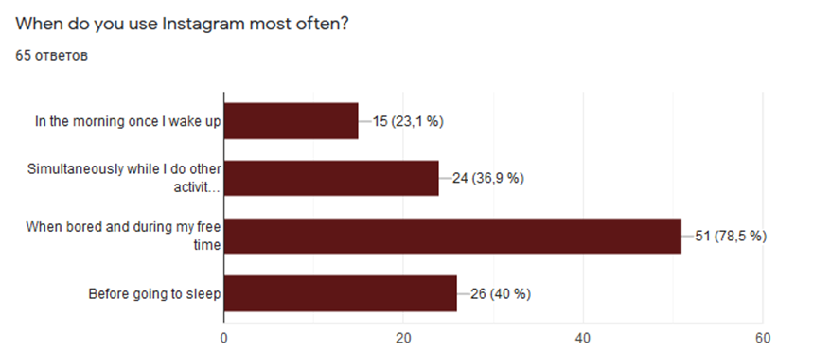
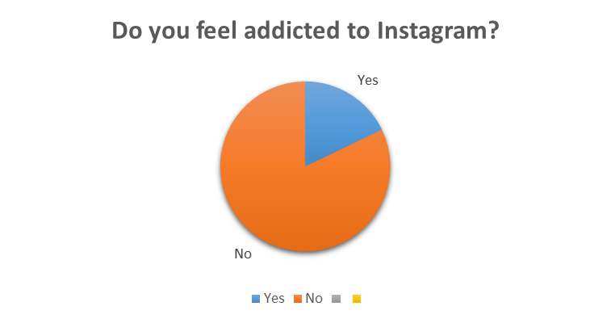
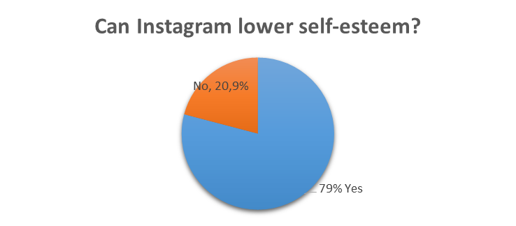
Survey results

Slide 15
Survey results
90% females
Most users were passive ones
In comparison with other social media platforms, the respondents prioritized Facebook more due to the content difference. Instagram is for leisure, when Facebook is for formal activities.
The majority of the respondents acknowledge the negative aspects of Instagram exposure, however, refuse to admit that in relation to themselves.

Slide 16
Instagram fasting experiment
The results were primarily based on participants’ responses who went on a 21-day experiment. The set of questions was developed to evaluate their relationship with Instagram and reported well-being. The results of the data analysis indicated that the experience of Instagram consumption varies in relation to different age groups. Teenagers seem to be more dependent on their created self-image and persona than college age group. The intend to conduct such a fast was mainly the result of them feeling socially disturbed. The constant feeling of being obliged to social comparison by their peers and the negative feelings that upward social comparison caused, exposure to distorted (overly positive) presentation, feeling meaningless or bored, and interpersonal quarrels were the leading factors for such a desire.
The experiment proposed that social media refusal focused mainly on positive mental outcomes.

Slide 17
conclusion
The present study confirmed that both, an active and passive usage of Instagram might negatively affect ones’ mental condition. The results of the survey revealed the interest of predominantly female audience towards this topic and the awareness of people about the negative effects of Instagram exposure, however the blind consumption does not allow some to realize and notice the mental burden hanging on their psyche. Unlike the survey, the experiment helped to establish a personalized approach to this issue and contact with young people. This allowed us to see different stances in accordance with age and gender and reveal mostly positive changes in the psychology of people. The majority of the participants reported improvements of their quality of life, including increased productivity and satisfaction. Although the information derived from the analyzed literature has significantly contributed to the formation of the theory, a further research in this area is recommended to be conducted. It is clear that it is too early to draw conclusions on many issues. However, we can say that social networks have a very different impact on people, depending on various conditions, and above all - on their personality traits.

Slide 18
bibliography
Bennett. E. (August 30, 2019) Instagram Fasting: The Low-Stress Way To Stop Social Media Making You Sad. Retrieved from: https://www.refinery29.com/en-gb/instagram-depression-anxiety-cures
Efimova. G.Z., Zyuban. E. V. Impact of the social networks on the individual. Online-journal “Mir nauki” 2016, volume 4 No 5.
El Khouly. C. (March 2018) Instagram and its Relationship between Self-Esteem and Depression amongst Young Adults. Dublin Business School, School of Arts. Retrieved from: https://esource.dbs.ie/bitstream/handle/10788/3460/ba_elkhouly_c_2018.pdf?sequence=1&isAllowed=y
Fioravanti, Giulia, Alfonso Prostamo & Casale Silvia. (2019). Taking a Short Break from Instagram: The Effects on Subjective Well-Being. Retrieved from: https://www.researchgate.net/publication/337339493_Taking_a_Short_Break_from_Instagram_The_Effects_on_Subjective_Well-Being
Kyle. F. (July, 2019), How to Beat Instagram Addiction Without Losing your Mind. Retrieved from: https://kenji.ai/blog/instagram-addiction/
Hanley SM, Watt SE, Coventry W (2019) Taking a break: The effect of taking a vacation from Facebook and Instagram on subjective well-being. PLOS ONE 14(6): e0217743. https://doi.org/10.1371/journal.pone.0217743
Rakhmawati, Nur Aini,(201X). What are inside the mind of teenagers on Instagram?. Retrieved from: https://www.researchgate.net/publication/338298724_What_is_inside_the_mind_of_teenagers_on_Instagram
Kircaburun, Kagan & Griffiths, Mark. (2018). Instagram addiction and the Big Five of personality: The mediating role of self-liking. Journal of Behavioral Addictions. 7. 10.1556/2006.7.2018.15. Retrieved from: https://www.ncbi.nlm.nih.gov/pmc/articles/PMC6035031/
Lockhart, Marisa. (2019). "The relationship between Instagram usage, content exposure, and reported self-esteem". Retrieved from: https://www.researchgate.net/publication/332751267_The_relationship_between_Instagram_usage_content_exposure_and_reported_self-esteem
Macmillan, Amanda. (May, 2017). Why Instagram Is the Worst Social Media for Mental Health. Retrieved from: https://time.com/4793331/instagram-social-media-mental-health/
Martinez-Pecino, Roberto & Garcia-Gavilán, Marta. (2019). Likes and Problematic Instagram Use: The Moderating Role of Self-Esteem. Cyberpsychology, Behavior, and Social Networking. 22. 10.1089/cyber.2018.0701. Retrieved from: https://www.researchgate.net/publication/333230835_Likes_and_Problematic_Instagram_Use_The_Moderating_Role_of_Self-Esteem
holeh, Achmad & Rusdi, Ahmad. (2019). A New Measurement of Instagram Addiction: Psychometric Properties of The Instagram Addiction Scale (TIAS). 91-97. Retrieved from: https://www.researchgate.net/publication/335947345_A_New_Measurement_of_Instagram_Addiction_Psychometric_Properties_of_The_Instagram_Addiction_Scale_TIAS
Trifiro, Briana, (2018). Instagram Use and It's Effect on Well-Being and Self-Esteem. Retrieved from: https://digitalcommons.bryant.edu/macomm/

